Slide 1

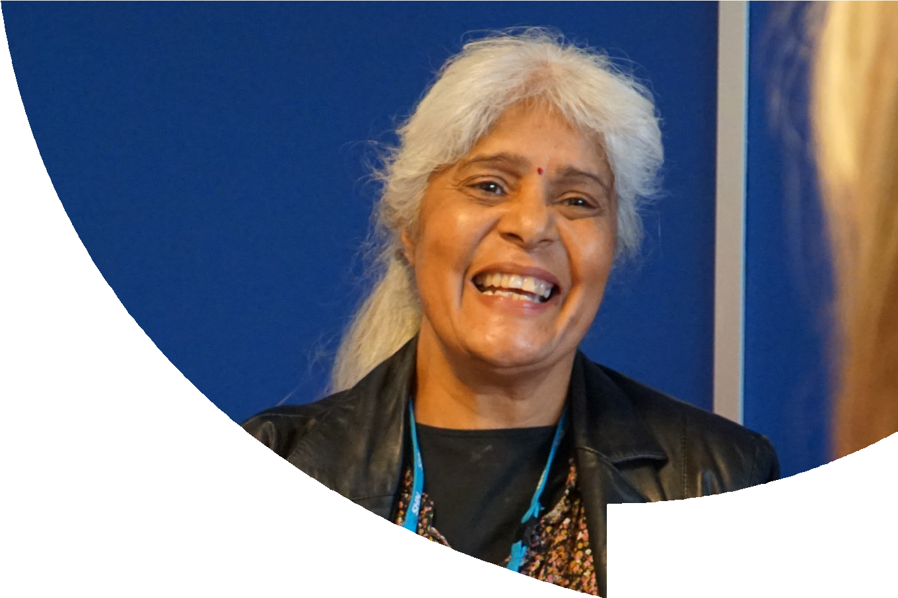
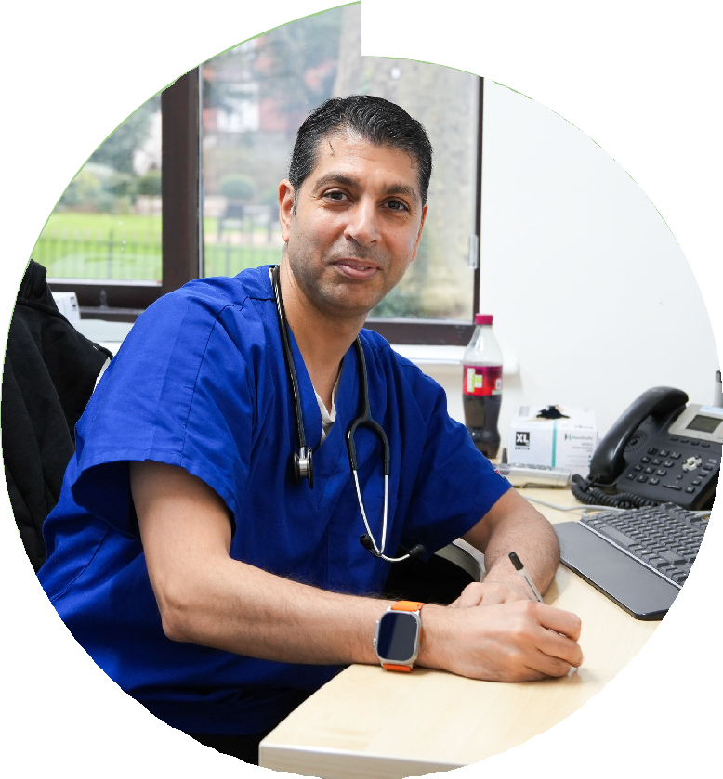
Coventry and Warwickshire
Primary Care People Plan
2024 -2029
Primary Care People Plan

Slide 2
Foreword
The Primary care workforce is the heart of healthcare provision within the system, serving as the first point of contact for most patients and providing essential,
ongoing care that enables people to start well, live well and age well, maintain their independence, and access
timely treatment.
The roles that the primary care workforce undertake go beyond individual treatment; they provide a crucial duty in promoting well being, delivering community health, addressing health inequalities, preventing illness, and reducing pressure on hospitals and emergency services.
and local landscapes. It proudly showcases the excellent work already happening across the system, the future ambitions and demonstrates the potential for growth and innovation with investment and resources.
To be part of the culture change that drives a positive narrative around Primary Care, we need compassionate leaders and teams to grow opportunities for existing and future workforce, harness the potential of all levels of scale, be innovative in shaping new employment and development models and share successes so they might be replicated across the system.
This strategy is particularly significant because it has been
co-produced in close collaboration with general practice across Coventry and Warwickshire, the Coventry and Warwickshire Training Hub and the ICB. The content was developed by those partners and reflects the priorities of the Primary Care Workforce.
The national drive is to shift the delivery of healthcare towards providing the best possible care as close to home as possible. To deliver on this ask we need to ensure we have a supported,
skilled, dynamic and fulfilled Primary Care workforce for the future. As a sector primary care continues to demonstrate flexibility and resilience that allows them to adapt to significant challenges.
This Plan explores the challenges in the context of both national
Alison Cartwright – Chief Integration Officer
Primary Care People Plan Working Group
The Plan is a key enabler in supporting the delivery of the Primary Care Strategy and we look forward to working together to bring this plan to reality, creating a strong, resilient and innovative workforce fit for the future.
Felicity Davies – Chief People Officer
Dr Cat Roberts - GP Workforce Lead, NHS Coventry and Warwickshire ICB
Dr Caroline Ward - Aspiring Leadership Fellow
Nikkie Temperley-Smith - Head of Primary Care, NHS Coventry and Warwickshire ICB
Tim Sacks - Director of Primary Care, NHS Coventry and Warwickshire ICB
Simon Doble - Deputy Director of Primary Care, NHS Coventry and Warwickshire ICB
Sue Phillips - Chief Operating Officer, Coventry and Warwickshire Training Hub
Martin Berisford - Communications and Engagement Lead, Coventry and Warwickshire Training Hub

Slide 3

Contents
OUR VISION, MISSION AND COMMITMENT
NATIONAL CONTEXT
COVENTRY AND WARWICKSHIRE CONTEXT DEVELOPING OUR PRIORITIES AND CURRENT DELIVERY FUTURE DELIVERY AND THE ASK
ENABLERS TO DELIVERY MEASURING SUCCESS CONCLUSION
PRIMARY CARE PEOPLE PLAN ON A PAGE APPENDIX
GLOSSARY

Slide 4
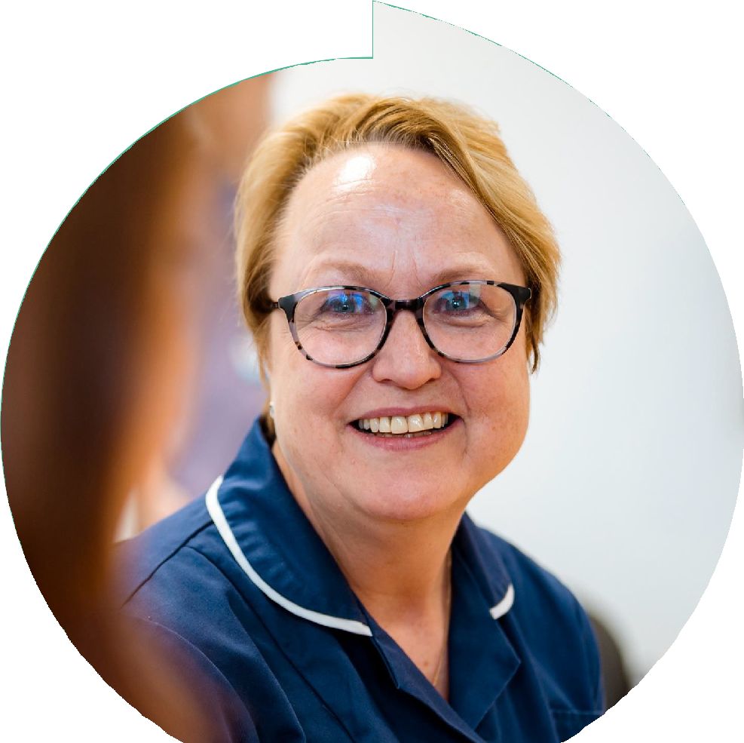
People at the heart of Primary care
Our Primary Care people are key to the delivery of excellent care to patients across Coventry and Warwickshire.
In creating the Primary Care People Plan, we look to highlight the challenges facing primary care and use this evidence to explore the opportunities and potential solutions that will support primary care into the future.
Vision
To attract, support, develop and retain our primary care people, ensuring they can meet their potential and feel valued and fulfilled in their work.
Mission
Ensure our people can grow and flourish through investment in education, wellbeing, collaborative and innovative working opportunities, equity and opportunity.
Commitment
Our leaders will ensure we have the culture and focus to enable our people to take care of themselves and each other, to support the delivery of high quality, patient-centred and sustainable care for the population of Coventry and Warwickshire.

Slide 5


Slide 6
The Fuller Stocktake Report 2022
Darzi Investigation of the NHS in England 2024
The report was ordered by the incoming government to provide a definitive view of NHS performance and inform the upcoming ten-year plan for health, expected in spring 2025.
The NHS Long Term Workforce Plan 2023
This plan sets out how the NHS will address existing vacancies and meet the challenges of a growing and ageing population by recruiting and retaining hundreds of thousands more staff.
Sets out a new vision in integrating Primary Care, improving the access, experience and outcomes for our communities, which centres around three essential offers.
Streamlining access to care and advice for people who get ill but only use health services infrequently:
providing them with more choice about how they access care and ensuring care is always available in their community when they need it.
It has identified the NHS is in serious trouble and the health of the nation is worse and it recommends the upcoming plan addresses the following:
Re-engage staff and re-empower patients.
This is focused on three key pillars
Train - increase training, increase apprenticeships and alternative routes, introduce new roles.
Providing more proactive, personalised care with support from a multidisciplinary team of professionals to people with more complex needs, including, but not limited to, those with multiple long-term conditions.
Change financial flows to promote and sustain the expansion of General Practice, Mental Health and Community services, embracing a multidisciplinary neighbourhood care team model.
Retain - support staff, boost flexibility, continue
to improve culture and leadership.
Reform - improve productivity by working and training in a different way, change training and education to deliver staff and roles to where they are needed most, ensure the right skills
to harness the opportunities of new technology.
Helping people to stay well for longer as part of a more ambitious and joined-up approach to prevention.
Improve productivity.
Tilt towards technology through digital systems.
The shifting focus is now onto developing integrated neighbourhood teams, places and systems, which gives us a great opportunity to build a new, more effective health service designed with our communities to fit their needs.
Clarify roles and accountabilities in NHSE and ICBs.
Direct effort at aspects that will drive national prosperity by supporting people to get back to work.

Slide 7


Slide 8
Local Context - Coventry and Warwickshire Primary Care Landscape
The Coventry and Warwickshire Integrated Care System provides health, care and wellbeing services and support to a diverse population of over 1 million people, and that population is growing.
With population growth concentrated in certain parts of the ICS, and the population profile varying between localities, a place-based approach to service planning remains important.
Primary Care and General Practice is the heart of our local health and social care system. It not only provides essential medical services to a registered patient list but also acts as the first point of contact for patients who need referral to both wider health service, and increasingly to social care and third sector / community assets.
In many ways, the Coventry and Warwickshire health and care system performs well. However, the ICS knows that the way people experience our system now is not always how we or they would want it to be. The ICS knows people want more focus on self-care and prevention and on support to be able to help themselves and their families.
It is rooted in our local communities and forms the basis for Primary Care and GPs to work together with other NHS organisations and services to address the challenges and improve the health of the local populations they serve. The Primary Care People Plan is an iterative plan and will grow to include our workforce working across community pharmacies, optometry and dentistry as those relationships develop. Our first iteration provides
a focus on our general practice workforce, at the core of our primary care landscape.
Alongside this, people tell us that they want services that are more joined up when they do need to access them, that understands their needs and history and are delivered closer to where they live where possible. Currently our system is not always able to deliver on this.

Slide 9





Our System in Numbers
Warwickshire North
6
Councils
4
Places
Thriving Voluntary and Community Sector
183
Pharmacies
£1,938
Billion Budget
(2023/24)
6
Collaboratives
4
Partner NHS
Trusts
2
Local
Authorities
2
Healthwatch
Orginisations
1
Intergrated Care
Partnership
20
Primary Care
Networks
1
Intergrated
Care Board
Rugby
1.07m
GP Registered
Population
119
GP Practices
105
Dental
Practices
25,900
NHS
Staff
112
Optometry
Practices
1
Ambulance
Service
Coventry
Our GP Practices by Place
Coventry
8 PCNs - 50 GP Practices
Rugby
1 PCNs - 12 GP Practices
South Warwickshire
7 PCNs - 32 GP Practices
South Warwickshire
Warwickshire North
4 PCNs - 25 GP Practices

Slide 10
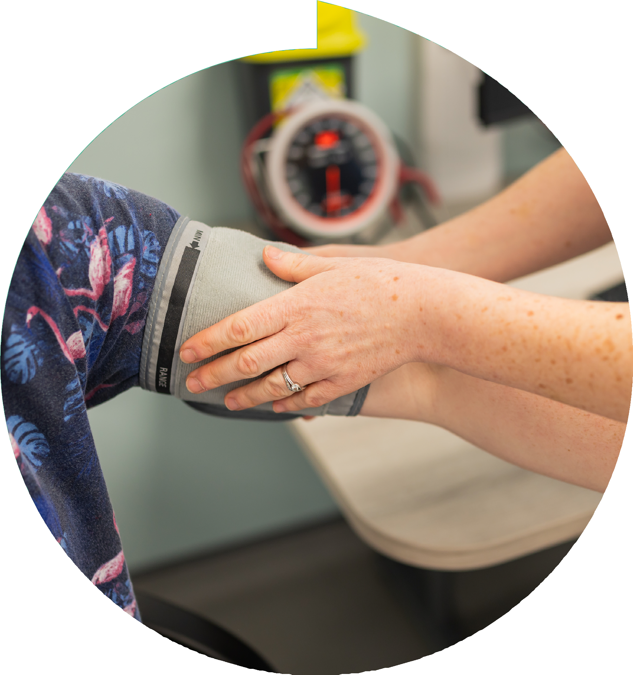
Overview of General Practice
GP Practices are small to medium sized independent businesses - they hold a contract with NHSE to deliver general medical services.
The ICB has delegated commissioning responsibility to oversee the contract - in terms of performance and certain ‘quality’ indicators.
Any services in addition to the contract are commissioned nationally and/or locally via ‘enhanced services’. Participation is optional – examples include covid vaccination and the PCN DES.
The PCN DES is the mechanism that provides the funding for the new multidisciplinary team additional roles that is now in General Practice. There are now 17 roles available for PCNs to employ.

Slide 11





The Current System Situation
The reality of primary care in Coventry and Warwickshire.General Practice across the country is experiencing significant challenges with declining GP numbers, increasing demand and sustained underfunding of services which has an impact on patient services. There are cultural, structural and financial challenges that make day-to-day life in the sector unsustainable. Patient satisfaction has suffered; there is financial instability due to short-term approaches to resourcing; and the digital and estates needed for basic service provision are not consistently fit for purpose.
Despite this, general practice is building on foundations of huge success in recent months and years, including responding to and recovering from Covid, with incredible teams improving service delivery and supporting patients in the face of increasingly challenging circumstances.
Increasing levels of demand, greater levels of need and longer waiting lists have all meant that more people are asking to see their GP more often, which is reflected in patient satisfaction rates, albeit that Coventry and Warwickshire performs well when compared at both regional and national levels. The public’s unhappiness with access is even more of an issue in deprived areas, which have significantly more demand than those areas with lower rates of multiple deprivation.
Primary care has struggled to find a meaningful home within the ICS to ensure the sector can have an influence and impact. Primary Care needs to have parity of esteem at a system level to meaning fully contribute to system development, this includes active involvement in formulating new pathways and opportunities, strategic planning, resource allocation, workforce and digital enablement.
GP practices have been at the forefront of the NHS’s digital developments, including ePR, e-prescriptions and online booking. Primary care lacks IT solutions that support communication between practices and other healthcare providers – especially secondary care, there is more to be done to support different practices and partners to speak to each other digitally, and to share and use accurate data across organisations. Practices will continue to need to embrace greater online access and consultation routes for a more digitally-informed public.
The sector faces significant workforce challenges including the recruitment and retention of clinical/non-clinical staff and the financial pressure of core staffing models. Increased demand for multiple reasons, including our ageing population, health inequalities and the pressure on secondary care systems is leading to increased waiting times. GP estates are extremely variable, ranging from modern buildings to premises unchanged for half a century. New ways of working and connectivity requirements mean the current estate does not have the capacity to manage increasing demand. New estate fills quickly, yet there is void space not fit for purpose.
With increasing financial pressures on everyone in the country, GP practices and their staff are no different. Practices are having to work harder and for longer to meet contractual targets; many funding streams are inflexible to local needs; and contract changes year on year have not include additional investment to counteract the damaging impact of inflation. On top of this, Primary Care has transfer of unfunded activity.

Slide 12



Local policy
In Coventry and Warwickshire, we have consistently taken a system-level approach to the general practice workforce, prioritising equity and resource optimisation.
This collaborative strategy ensures that initiatives, training programs, and support offers are accessible to the entire workforce, regardless of role or location.
By working collectively across the system, we eliminate duplication, share best practices, and pool resources to maximise impact
and efficiency. This inclusive approach enables us to address workforce challenges holistically, ensuring that all staff benefit from development opportunities and support, while fostering a cohesive and sustainable general practice workforce.
In creating this Primary Care People Plan, we have endeavored to align with existing strategies including the Coventry and Warwickshire One People Plan, the Coventry and Warwickshire Training Hub and the Primary Care Strategy.

Slide 13

Recruitment Channels
The current workforce pipeline in general practice reflects traditional recruitment methods and also includes the introduction of NHSE-funded multi-disciplinary
team roles (ARRS) through the Primary Care Directed Enhanced Services (PCN DES) since 2019. These roles grew rapidly, but future growth is not anticipated.
General practice in Coventry and Warwickshire benefits from strong relationships with the local medical and GP schools, supporting high numbers of medical students and GP Specialty Registrars (the highest number per 1K population in England).
While additional resources and innovative placements could increase these numbers further, challenges remain in expanding work experience, apprenticeships, and non-GP placements due to limited demand, resources, and system support.
Despite these challenges, innovative employment models present an opportunity to attract and develop the future workforce.
*Needs to be invested in more/grown

Slide 14

Workforce Growth and Composition
The General Practice Workforce is 2815 WTE (whole time equivalent) at September 24.
This equates to approximately 3700 people:
16.10%
general practice
workforce growth
(excluding Additional Roles)
10.19%
population growth
731
WTE GPs
239 are GPs in training
240
WTE Nurses
166
WTE
Direct Patient Care
(Non Additional Roles)
1155
WTE
Administrative and Clerical
523
WTE
Additional Roles
via funding from the PCN DES
vs

Slide 15









GP Practices and Workforce Trends
Regional Benchmarks and Demographics
Coventry and Warwickshire employs more GPs and Additional Roles roles per 10k population than national/regional averages.
March 2019 to September 2024
6% reduction
in GP practices
Midlands (8.9%)
and England (10.8%).
vs
Coventry and Warwickshire employs fewer nurses, administrative and clerical and Direct Patient Care roles per 10k population compared to
Workforce ethnicity aligns with local demographics (80% white), whilst the GP workforce is more diverse (43% white).
103% increase
in GPs in Training
33% increase in Salaried GPs; 15% decline in
GP partners (lower than Midlands/England averages).

Slide 16
Engagement Process
To progress the Primary Care People Plan, it was essential to ensure the voice of the General Practice workforce was captured and reflected throughout.
Since the start of 2024, we’ve held multiple primary care engagement eventstounderstand the key issues from over 250 primary care clinicians and practice staff.
Strategy Group | Workshop Jan 2024 | Webinar July 2024 | Questionnaire | Stakeholder updates
 |  |  | August 2024
ICB Primary Care Workforce Lead Head of Primary Care Training Hub COO and CO Aspiring Leadership Fellow Director and Deputy Director of Primary Care | General Practice Stakeholders and Partners Identified key themes regarding challenges and opportunities | Systems wide update on work program Enabled us to poll audience | 189 responses to our survey exploring themes around our four pillars | Primary Care Collaborative Training Hub and Primary Care Workforce Board ICS People Board

Slide 17
What the Primary Care Sector has told us
The key themes from the range of views we have heard:
Retention
More attractive opportunities in other countries or private sector, lack of flexible working opportunities, financial constraints to pay progression, variation in pay
and culture across practices.
Training and supervision
Increasing number of learners requiring supervision and “head space”, requirement to provide supervision to wider workforce roles, needs of learners more complex and require more time.
Career Progression
Lack of innovative employment models, unclear pathways for career progression, lack of succession planning, variable access to leadership development opportunities.
Workload
Increasing demand, drive to improve access, more complex patient needs, impact of waiting lists and work transfer from other providers.
Estates
Limited space for training and
supervision, need to host multidisciplinary workforce, estates not fit for purpose and requiring renovation or expansion.
Morale
Impact of negative media portrayal, loss of fulfilment as unable to provide continuity/access
required, burnout and moral distress, lack of recognition and feeling unvalued and unheard.

Slide 18


Slide 19





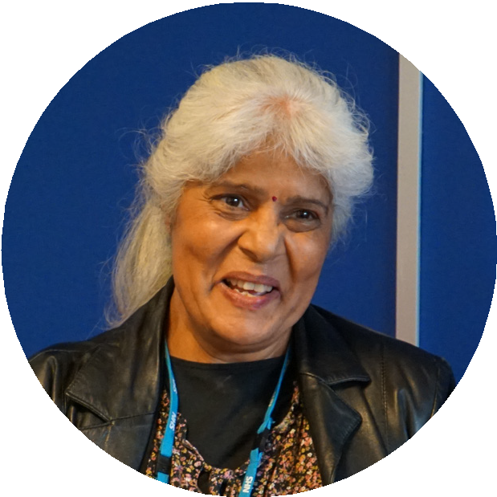

Our Four Pillars
Attract
Develop
Our “Four Pillars” approach was developed in 2019 when we agreed a system level approach to primary care workforce would provide most opportunity for impact, equity, effective use of funding, and access for all our people.
Collaborating with system colleagues to provide people pipeline
Delivering thousands of training, education and CPD
opportunities
Create conditions for quality placements which showcase general practice
Developing our workforce for the benefit
At the heart
of our staff, employers,
and patients
of General
The “Four Pillars” also represent the broad themes of ATTRACT, DEVELOP, RETAIN and SUPPORT that have been identified as priorities and areas of challenge during engagement with the primary care workforce.
Practice
To understand the needs of the workforce and look to provide a range of offers to support retention
Delivering a comprehensive health & wellbeing package
Ensure equality, diversity and inclusivity are embedded in our way of working and the programmes we offer
Develop schemes and tools to transform mindset and ways of working
We have aligned our “four pillars” to our four ICS People Plan priorities and CWTH strategic priorities to ensure collaborative working, a shared vision and opportunities to deliver workforce transformation.
Retain
Support
Attract, Recruit and Retain | People Development | System Culture and Organisational Development | Workforce Transformation
Employability Attraction and Retention | Future Skills | Equality, Diversity & Inclusion Health & Wellbeing | Workforce Efficiency and Redesign People Services Improvement
Primary Care People Plan

Slide 20

ATTRACT
Drive a positive narrative around the benefits of working in
Primary Care
e.g. capture the voices of our people and produce case studies for newsletters and websites.
Grow the number of apprentices, placements and work
experience opportunities
e.g. work with general practice, PCNs and all levels of at- scale provision to provide opportunities for non-clinical and clinical placements such as student nurse placements via Coventry University and paramedic placements with Worcester University.
Encourage and promote flexible and innovative employment
models, working patterns and opportunities at all levels of scale
e.g. term time working, hybrid/rotational employment opportunities.
Create and promote the routes into working in Primary Care
e.g. collaborations with local schools, further education institutions and higher education institutions.

Slide 21

RETAIN
Share information regarding different ways of working and
employment models to encourage a new ‘norm’
e.g. showcasing good practice and examples of innovative
retention models.
Seize initiatives as they arise to maximise opportunities for the
whole workforce
e.g. system schemes.
Address challenges as they arise in a creative and positive manner
e.g. create new innovative placements for GP Specialty Registrars.
Showcase success – each time, every time
e.g. shout about all the positive things that happen locally.

Slide 22
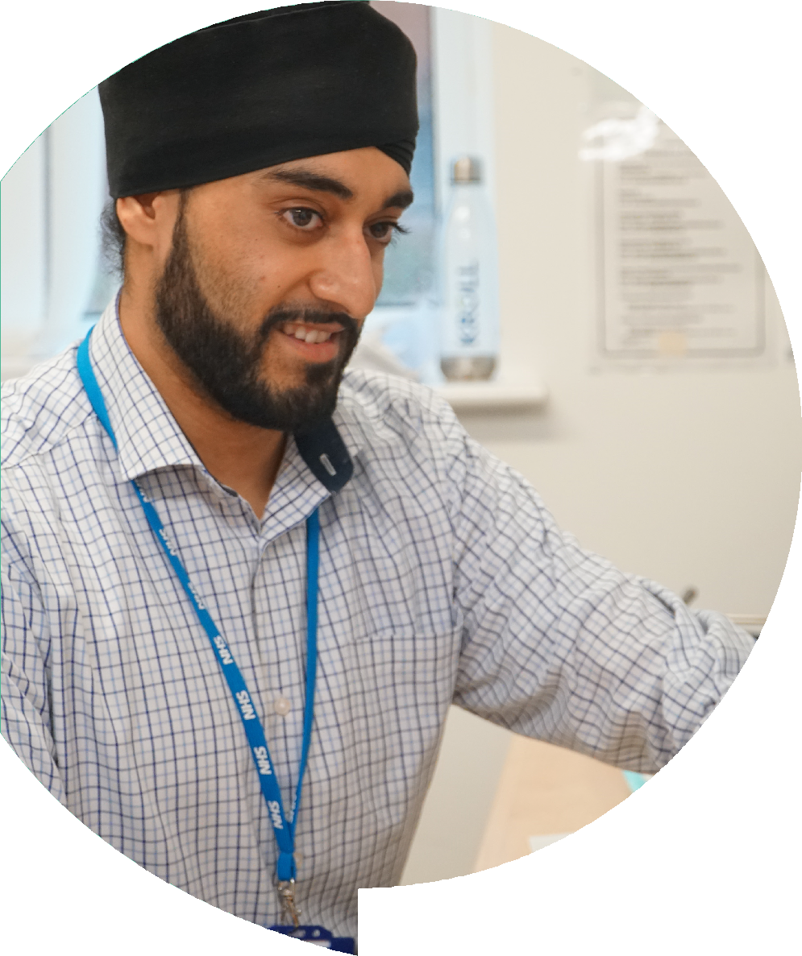
SUPPORT
Provide easy access to a variety of resources offering formal and informal support for our people
e.g. mentoring and Freedom to Speak up Guardians.
Train our leaders to be confident to support the workforce,
equipping line managers in compassionate leadership
e.g. ensure our managers and leaders have undertaken mental health training.
Create a culture where we are confident primary care is a great
place to work
e.g. health and wellbeing champions, staff networks and surveys.
Recognise and support our diverse workforce, providing equal opportunity for all
e.g. ensure we capture feedback and data and use this to ensure all of our people are included.
Welcome positive transformation and change as a conduit to
creating opportunities for our workforce to flourish
e.g. optimising all levels of scale to ensure diverse employment opportunities.

Slide 23

DEVELOP
Train our leaders and ensure we have a future pipeline of leaders
e.g. PCN CD and Aspiring CD programme; Aspiring Leaders Fellowships; Future Leaders
Prepare our people to reform/transform as primary care adopts new ways of working, enabling further successful integration and joint working for services and clinical pathways
e.g. skilling our people to deliver the Primary Care Strategy
Communicate the Coventry and Warwickshire ‘offer’ – and why
it is a great place to live and work here
Provide our people with the skills to maximise the opportunity that will be provided with new employment models and roles to meet the needs of the local population
e.g. frailty nurses

Slide 24
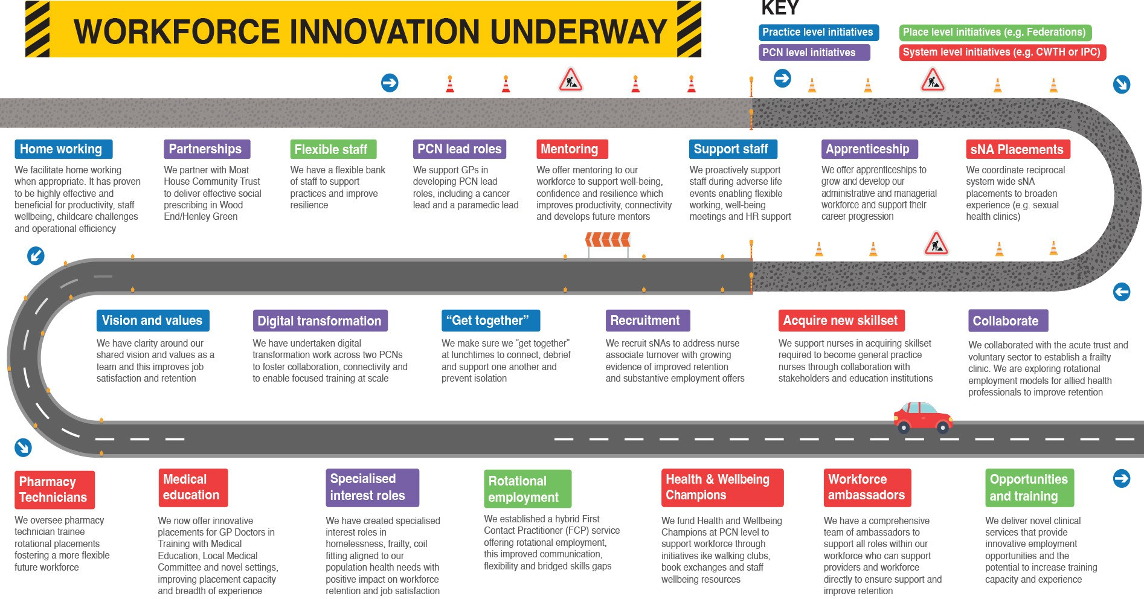

Slide 25
ATTRACT
RETAIN
AIMS: Understand the needs of our future workforce. Create conditions for quality placements which showcase general practice.
AIMS: Understand the needs of the workforce and provide a range of offers to support retention.
DONE
DOING
DONE
Promoting the unique selling points of working in general practice
Pioneered innovative schemes such as Aspiring Leader Fellowships
Ensured workforce offers open to all including locums
Build on opportunities created by the PCN DES around
multidisciplinary workforce skill set in Primary Care
Share best practice
Pilot Exit Interviews
Launch mentoring for the GP workforce
Drive a positive narrative
Employing the workforce using innovative employment models
DOING
Create placement capacity to drive a pipeline of our future workforce e.g.
Student Nursing Associates
Expand Exit Interviews into a permanent offer and
utilise feedback
Expand the mentoring offer to the wider workforce
Primary Care People Plan

Slide 26
DEVELOP
SUPPORT
AIMS: Deliver a comprehensive Health and Wellbeing package. Ensure equality, diversity, inclusivity and belonging are embedded in our ways of working and the programs we offer.
AIMS: Deliver thousands of training, education and CPD opportunities. Develop our workforce for the benefit of our people, employers and patients.
DONE
DOING
Invested in ‘champions’ for all
the roles in general practice/PCN workforce e.g. GP, nurse leads and Ambassadors for the personalised care roles
Strengthen the health and wellbeing offer based on activity and feedback
DONE
Delivered a comprehensive education and training package
Continue to review and develop the support offer based on the ever- changing workforce
Provide a Health and Wellbeing offer
DOING
Created and promoted workforce website
Continue to improve workforce data quality to support workforce planning
Support the development of our Future Leaders (aligning to the ICS CCPL programme)
Commenced peer network programmes for clinical workforce
Recognise and support our diverse workforce
26

Slide 27


Slide 28




Predicting Future Workforce
Our workforce pipeline in general practice is varied and complex, influenced by dynamic factors that make it challenging to predict and create accurate trajectories.
Variables such as training capacity, retention rates, career transitions, and external influences like policy changes and economic conditions all play a role in shaping the pipeline.
Additionally, the evolving demands of healthcare, technological advancements, and shifting workforce preferences further complicate forecasting.
Identifying the future workforce requirement is harder over time:
The ‘Cone of Uncertainty’ means our best line of sight is the future needs of people (patients and our workforce) and our ambitions for how we will deliver care – our Primary Care Strategy. We will need to shift our focus on the skills and shape of our workforce rather than trajectories and number.
This complexity necessitates a flexible and adaptive approach to ensure that we can respond effectively to workforce needs as they arise.

Slide 29

Primary Care Strategy - Workforce Priorities
To meet to the ask of the Coventry and Warwickshire Primary Care Strategy,
we have identified five key priorities for our People Plan.
Supporting our people to create the right conditions for change - supported by innovative commissioning and contracting
Develop primary care leaders – who have the skills/confidence/experience
to operate at a systems level
Workforce transformation skills - to recognise what we have, what is needed (planning) and how transformation can be managed, plus the move to MDT working (new roles/new skills/new ways of working)
A clear workforce support and development offer – ranging from Health and Wellbeing offers and support through to portfolio careers and system level working
Ascertain what skills are needed for the future and having a plan to close the gap, especially IT and digital/MDT and collaborative working

Slide 30
Workforce Priority One: Creating Conditions for Change
AIMS WORKFORCE NEEDS
CHANGE IDEAS / ACTIONS
SYSTEM NEEDS
Establish conditions to foster and sustain meaningful change in primary care, focussing
on commissioning behaviours
and provider
responsibilities in order to support workforce
Clear and supportive commissioning framework to enable primary care transformation
Clarity around governance and accountability for resource allocation and priorities
Creation of a shared vision for change and transformation
Joint professional development sessions for commissioners and provider to gain a shared understanding of organisations, sectors and providers
Training and professional development for commissioners and providers to improve understanding
Sustainable resource management and contracts allow time for change/ transformation to embed
Development of governance structure to support collaborative decision making, ensuring clarity and transparency and clear outcome measures
Sustainable transformation and moving care closer to home
Leadership and change management capabilities to deliver transformation
Foster a culture of continuous improvement and shared responsibility for patient and workforce outcomes
Engage and empower stakeholders so our focus in based on their reality
Outcome measures
Risks
Primary care representation and voice
Successful long term resource allocation to primary care and proportionate outcome measures
Increased provider engagement and satisfaction and ownership
Improvement in outcomes and cost-efficiency
Misalignment between commissioning ambitions and provider capability/resources
Lack of accountability and transparency leading to breakdown in trust
Lack of ongoing system commitment to adequate resource allocation
Resistance to change due to overburdened workforce and national policy

Slide 31
Workforce Priority Two: Primary Care Leadership
AIMS WORKFORCE NEEDS
CHANGE IDEAS / ACTIONS
SYSTEM NEEDS
Develop our primary care leaders for today and the future, giving them the skills and confidence to drive change in primary care and the system.
Ensure strong voice of primary care
Career progression and development pathways
Investment in our leaders of the future and leadership development pathways
Driving system priorities and resource allocation
Succession planning and ability to nurture and train our future workforce
Portfolio working opportunities
Rotational and flexible employment opportunities
Transformation – supported by clear governance and commissioning
Empowerment and recognition
Create conditions to facilitate experience
Outcome measures
Risks
Participation and engagement
Diversity of our leaders (profession, roles, background, ethnicity)
Evidence of leadership role attainment
Evidence of nurturing future leaders
Primary care leaders delivering system change
Lack of engagement from system partners
Lack of resourced time/investment
Lack of ongoing commitment to funding and access opportunities
Fear/stigma of undertaking leadership roles

Slide 32
Workforce Priority Three: Workforce Transformation
AIMS WORKFORCE NEEDS
CHANGE IDEAS / ACTIONS
SYSTEM NEEDS
To equip primary care providers with skills and capabilities to adapt to changing demands, adopt new ways of working, and drive
innovation in service delivery.
Skilled workforce for transformation –
proficient in adapting to change
Long term funding for service delivery providing security for practices to invest in staff
Training and support for providers in workforce transformation skill
Collaborative learning opportunities and sharing of best practice
Technological adaptation – leveraging digital tools and data analytics
Enhanced communication and understanding the evolving landscape, changing needs and the “ask”
Workplace culture fostering training and time adapting to change
Prioritise retaining knowledge, wisdom and advanced skills
Sustainable workforce models and training capacity
Pride in role and understand importance of multidisciplinary skills
Training needs analysis to understand skills required and how to deliver (e.g. digital, behavioural health, decision-making, risk management etc.)
Outcome measures
Risks
Workforce reports increased satisfaction and engagement with roles
Improved workforce retention and stakeholder satisfaction/engagement
Increased examples of innovative training and employment opportunities
Increased examples of workforce transformation aligned to population health management needs
Resistance to change
Inadequate resources
Inequitable access to opportunities
Misalignment of skills and evolving needs of primary care delivery

Slide 33
Workforce Priority Four:
Workforce Support and Development
AIMS WORKFORCE NEEDS
CHANGE IDEAS / ACTIONS
SYSTEM NEEDS
Develop a comprehensive workforce support and development offer enhancing skills, support staff wellbeing, attract future workforce and meet evolving needs of our system
A thriving primary care system level workforce with skilled, motivated and fulfilled people
Recognition and reward, confidence and competence – including training, career
advancement and development
Comprehensive education, training and workforce support offer delivered at a thriving primary care system level
Robust health and wellbeing offer delivered and accessible at all levels of scale
Primary care workforce able to adapt to changing needs of population
Organisational cultures supporting health and wellbeing, valuing their people
Creation of clear feedback and recognition systems for all workforce – including opportunities for career development and progression
Opportunities for interdisciplinary learning and collaboration to improve understanding and sense of team
Collaborative working ensures we have skills and resource required to deliver care closer to home
Organisational cultures that foster equality, diversity, inclusivity and belonging
Equality, diversity, inclusivity and belonging at the centre of workforce support offers including recruitment and retention strategies
Outcome measures
Risks
Workforce reports increased satisfaction and engagement in roles
Improved retention and recruitment
Engagement with training programmes and support offers and representation of diverse groups
Workforce demographics are representative of populations and communities they care for
Burnout due to service delivery pressures
Inadequate resources and time to access offers
Inequitable access to opportunities
Failure to fully capture impact due to complex landscape and levels of scale

Slide 34
Workforce Priority Five: Future Skills
AIMS WORKFORCE NEEDS
CHANGE IDEAS / ACTIONS
SYSTEM NEEDS
Identify and develop future skills required in workforce to address evolving healthcare demands, improve care delivery
closer to home and increase workforce satisfaction
Highly skilled and resourced primary care workforce matching health needs of population
Build competency in clinical areas to meet population and innovation need (e.g. chronic disease, frailty, digital, lifestyle medicine)
Comprehensive future skills forecasting through training needs analysis and collaboration with stakeholders and academic institutions
Primary care involvement in curriculum development and professional development offers
Pipeline of future workforce and culture of change readiness
Adaptability and lifelong learning
Cultural competency and health equity training offered and accessible to all workforce
Opportunities for interdisciplinary learning and team-based learning around clinical focus areas based on population health management principles
Collaborative care models and team-based approach to care ensuring skills and resources are closer to home
Time and resource to focus equitably on health promotion and preventative care
Technology and digital training to support use of emerging health technologies
Outcome measures
Risks
Undertaking a training needs analysis for future skills and tailoring offers to varied population demographics
Increased workforce competency in emerging skills (digital, chronic disease, lifestyle coaching etc.)
Recruitment and retention of workforce with appropriate skills to meet population health needs
Improved cultural competency and awareness of social determinants of health within workforce
Commitment to invest in people by all providers
Engagement and satisfaction with training and education offers to support future skills development
Resistance to change
Lack of shared vision and values across system stakeholders
Inadequate resourcing to support future skills development in workforce delivery of care closer to home
Disempowered and disillusioned workforce asked to innovate and do more

Slide 35
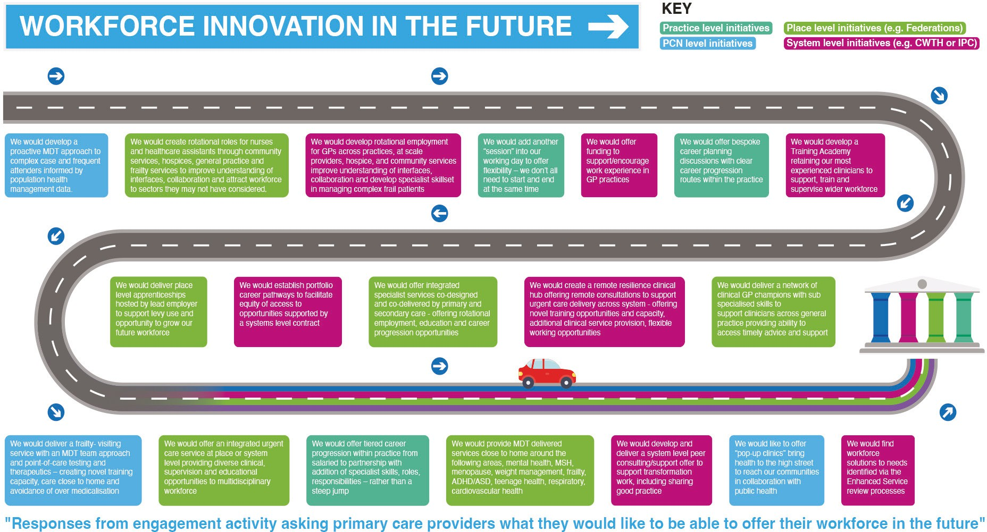

Slide 36
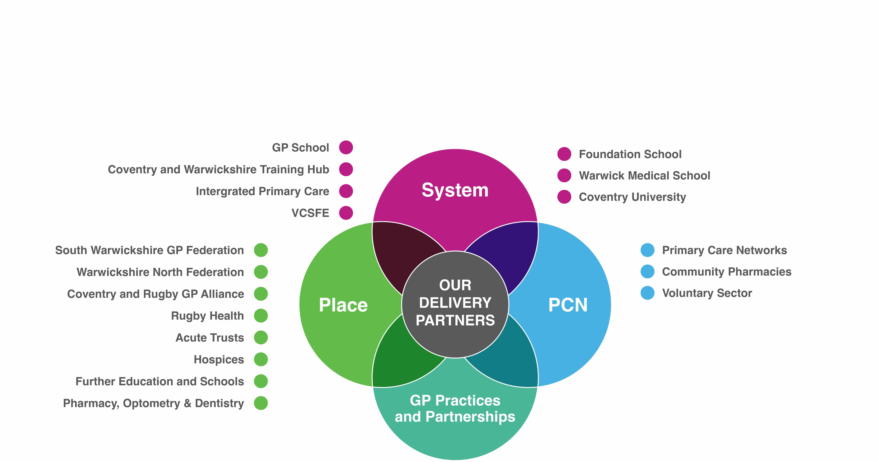
How we will deliver the plan
EMBRACE
CHAMPION
INNOVATE
SHARE

Slide 37


Slide 38
Financial Strategy and Resource Allocation
Effectively managing and utilising resources aligned to the delivery of our Primary Care People Plan is crucial to achieving the strategic priorities and ambitions for our current and future workforce needs and system service delivery models. This will include a focus on new models of employment, career progression, portfolio careers and training, supervision and ongoing development of an integrated workforce model.
Strategies to Achieve our Plan
Adopt a resource allocation model that redistributes funding to areas with the greatest health needs.
The Integrated Health and Care Delivery Plan reflects this commitment by prioritising funding growth for primary, community, and preventative services over traditional acute, hospital-based services.
The aim is to maintain acute expenditure at current funding levels (flat cash), thereby reducing its share of the total system allocation and enabling a greater investment in primary care.
This is consistent with Darzi’s message that systems should ‘hard wire’ financial flows into Primary/Community care.
The ICB in collaboration with ICS Partners will continue to develop relationships
and education/learning and employment arrangements to support achievement of the primary care people plan.
By implementing these strategies, over time the ICS aims to create a sustainable workforce framework that supports a holistic approach to ensure we have the support and strategies in place to attract, develop, support and retain our workforce to enable the delivery of our primary care people plan and our primary care strategy.

Slide 39
Investment in the General Practice Workforce
Outputs:
A diverse programme to attract, support, develop and retain the whole general practice workforce of 3700 people commissioned via the Coventry and Warwickshire Training Hub.
Focus:
  Investing in our future leaders.
  Strong wellbeing and support offer.
  Ensuring our workforce have skills for today and the future.
  Workforce and succession planning.
Robust governance and performance reporting.
The certainty of future funding from NHSE and the ICB allows the continuing investment in the growing primary care workforce. It is vital that our people evolve in line with national and local priorities and there is robust governance and oversight of the investment and programmes of work.
Source | Time period | Budget | Value Per Annum
NHSE WTE | 22/23 to 25/26 | Training Hub Contract | £308k
NHSE via ICB | 22/23 to 25/26 | Service Development Fund | £480k
ICB | 23/24 to 25/26 | Workforce Development | £700k
ICB | 23/24 to 25/26 | Primary Care Medical Education | £280k

Slide 40
Governance and reporting
The oversight and delivery of the Primary Care People Plan will be reported at Primary Care Group using a performance tracker. Updated progress will be shared at People Board and Primary Care Workforce and Training Hub Board.
Collaboratives Commissioner Provider
Coventry Care Collaborative
Integrated Care Board
Integrated Primary Care
Warwickshire Care Collaborative
People Board and Associated Working Groups
Primary Care Group
Coventry and Warwickshire Training Hub
Other Collaboratives
Acute Provider
Learning Disability & Autism
Mental Health
Primary Care
Training Hub and Primary Care Workforce Board
Practices
PCNs
Federations
Primary Care People Plan
Commissioning
Commissioning
Communications
40

Slide 41


Slide 42
PCPP What next
Driver
Deliverables
Co-produced longer term outcomes based contracts
Training and development to support current and future commissioners and providers
Primary Care Strategy in place with defined priorities and agreed deliverables
Shift to population health and delivery of care closer to home
Integrated neighbourhood teams and delivery at scale
Supporting the conditions for change - innovative
commissioning and contracting
Developing primary care leaders
A wide range of diverse and accessible leadership opportunities offered to the workforce
Ensure primary care involved in the design of opportunities at system level
Ongoing investment in our people and opportunities to gain experience in a safe environment
Workforce transformation skills
Ascertain the need/requirement in primary care to deliver change and to support training and development in this area
Develop and support transformation teams
Encourage and support sharing of best practice and innovation

Slide 43
PCPP What next
Driver
Deliverables
Ascertain Future skills
Engagement with primary care workforce to ascertain need and then develop a training, education and support package to close the skills gap
Look at opportunities to share skills across providers and roles
Support using a variety of channels and learning methods
Clear support and development offer
Ensure a clear and robust strategy in place
Continue to develop a clear and concise communication strategy
Embrace our diverse workforce by ensuring equity of access and opportunity for all
Seek feedback on a regular basis to refine the offer
Processes
Continue to invest in the primary care workforce
Ensure ongoing communication and engagement with primary care, and seek feedback to continue to
refine the training, education, development and support offer
Maintain and build on a primary care voice to help shape and deliver service transformation

Slide 44
PCPP What next
Driver
Deliverables
Enablers
Resources allocated in line with the scale of change and the development of integrated neighbourhood teams and the shift to care closer to home
Longer term co-produced/co-designed outcomes based contracts
Continue to ring fence funded to support the training, education and development of the primary care workforce
A greater system understanding of primary care – how it is contracted and works and the makeup of the workforce
Sharing best practice and supporting innovative working and delivery models
Ensure alignment with our key enablers – Primary Care Strategy, One People Plan and digital and estates strategy

Slide 45
PCPP What next
ATTRACT
The what | The how | The who | The when | The why
Ensure high quality learner environments are in place | By implementing the NHSE WTE Quality Assurance framework at practice or PCN level | CWTH - A small team of Learning, Assurance and Placement Officers led by the TH Quality Assurance | 2025 to 2027 | To ensure all learners experience a high quality learning environment thereby encouraging them to return to work in general practice. This is all
 | Health Education England (HEE) Quality Framework from 2021 — Publications | Lead is implementing the about investing in the future workforce framework in partnership pipeline – a key objective of the NHS with GP practices and PCNs Long Term Workforce Plan
 |  |  |  | NHS England » NHS Long Term
 |  |  |  | Workforce Plan
Increase placements | By working at a system level | ICS People Team supported | 2025 to 2030 | The NHS Long Term Workforce
and apprenticeships | (ICS) to support clinical and | by the ICB and CWTH |  | Plan was published in 2023. The
to grow our future | non clinical placements |  |  | plan includes the aim to increase
workforce |  |  |  | the use of apprenticeships, aiming
 |  |  |  | to provide 22% of all training for
 |  |  |  | clinical staff through apprenticeship
 |  |  |  | routes by 2031/32, up from just 7%
 |  |  |  | today. To support this ambition, the
 |  |  |  | plan aims to reach 16% by 2028/29.

Slide 46
PCPP What next
ATTRACT
The what | The how | The who | The when | The why
Look to increase the | To work with practices and | CWTH supported by the ICB | 2025 to 2030 | We need to ensure we have the
number of practices/ | PCNs to implement the QA | and the Higher Education |  | appropriate resources in place to
PCNs offering | framework and increase the | Institutes and GP School |  | support the development of our future
opportunities for | support offer for educators |  |  | workforce pipeline. We need high
learners | and supervisors via the |  |  | quality learning environments, well
 | Training Academy – once |  |  | resourced and supported educators
 | in place both will support |  |  | and supervisors and very close
 | an increase in both the |  |  | alignment with the providers of our
 | number of practices/PCNs |  |  | future workforce ie HEIs and GP
 | that can support learners but |  |  | School
 | also increase the range of
 | learners to include the multi-
 | disciplinary team roles and
 | especially nursing roles

Slide 47
PCPP What next
DEVELOP
The what | The how | The who | The when | The why
Increase the workforce planning | Ensure workforce data is presented regularly | ICB Primary Care Team and CWTH | Ongoing | Workforce planning helps identify what resources are in place and what
skills in general practice to enable efficient utilisation of resources both today and in the future | Provide training and education opportunities to develop skills e.g. utilisation of NWRS | NHSE WTE ICS At Scale providers | is needed in the future allowing time to make the necessary workforce changes – recruitment, up or reskilling etc
Ensure plans and | Develop and deliver training | Key stakeholders across the | Ongoing | A highly and appropriately skilled
a programme in | and education that meets | ICS. Programmes need to |  | workforce provides job satisfaction
place to fill the skills | the needs of the workforce | be devised both specifically |  | and supports workforce retention
gaps identified in | today and in the future | for general practice and/or |  | and delivers high quality patient
the Primary Care |  | ensuring general practice |  | care
Strategy |  | has equity of access
Increase knowledge | Produce an on line video | CWTH and ICB Primary | Ongoing | To ensure system partners have
of ICS partners | induction programme | Care Team |  | the opportunity to increase their
regarding general | that facilitates an easily |  |  | knowledge of general practice and
practice | accessible overview of |  |  | how it works/makes decisions/
 | the local general practice |  |  | allocates resources and provides high
 | landscape |  |  | quality patient care

Slide 48
PCPP What next
SUPPORT
The what | The how | The who | The when | The why
Develop a robust | Establish a Training | CWTH supported by ICB | 2025 to 2027 | In order to ensure we have a highly
offer to support | Academy | funding |  | skilled workforce and be able to
our educators and |  |  |  | increase the workforce to meet
supervisors |  |  |  | demand we need to be able to
 |  |  |  | provide our future pipeline. Educators
 |  |  |  | and supervisors are key to this
 |  |  |  | investment in people
Continue to engage | Ongoing dialogue, | ICS, CWTH and all providers | Ongoing | Our people sit at the heart of
with the workforce to | ascertaining need and |  |  | general practice and ensuring they
shape future offers | working with system partners |  |  | are supported is vital in the delivery
and investment | to deliver a robust support |  |  | of patient care
 | offer
Ensure equal | Ensure general practice is | ICS | Ongoing | General practice is the cornerstone
opportunity for | represented and heard at all |  |  | of the NHS and manages 90% of
general practice | levels |  |  | all activity across the system– its
in system level |  |  |  | workforce should be provided with
schemes |  |  |  | equal opportunity/access to all system
 |  |  |  | level schemes

Slide 49
PCPP What next
RETAIN
The what | The how | The who | The when | The why
Provide portfolio | Create innovative | ICS, CWTH and all providers | Ongoing | As resources and patient care shifts
careers and | employment and leadership |  |  | to a community based approach it is
leadership | opportunities |  |  | important that general practice leads
opportunities |  |  |  | this change. Innovative contracting
 |  |  |  | and flexible working will offer the
 |  |  |  | opportunity for those in general
 |  |  |  | practice to lead on the transformation
 |  |  |  | required to deliver healthcare in the
 |  |  |  | future
Develop stronger | Commission lengthier | ICS/ICB | Start 2025 and | Longer term contracts allows the
commissioning | outcomes based contracts |  | ongoing | provider to invest in its workforce
arrangement to |  |  |  | and supports recruitment and
provide greater |  |  |  | retention outcomes based
workforce security |  |  |  | commissioning moves the system
 |  |  |  | away from counting unit to
 |  |  |  | measuring outcomes – resources
 |  |  |  | are directed to delivering tangible
 |  |  |  | benefits for the workforce and
 |  |  |  | patients

Slide 50
Impact and outcomes
Our Plan sets out bold ambitions for our Primary Care People - set out below is the intended impact of realising our ambitions.
For The Public
Improved appropriate access to Primary Care
Greater choice and ways to personalise care
Improved continuity of care for those who need it most
Care provided in the right place, by the right person, at the right time
Those with complex needs are
better managed and monitored
Improved quality of life by being proactively supported within the community
Increased trust in the system and our services
Better remote monitoring support to allow people to remain as independent as possible
Safer and more efficient services
For Our People
Improved wellbeing
Greater resilience within teams
Confidence in compassionate
leaders
Greater satisfaction and productivity through clearer career structures and progression opportunities
Being recognised for the care we deliver and feeling valued
Feeling supported to take
on opportunities for personal development and improvement
A safe and healthy environment with
work flexibility
Increased parity of esteem across workforce roles
Equipped with the skills to make the best use of resources
For Our Primary Care Providers
Greater potential to support care closer to home
Improved working with system partners, with a greater appreciation for different roles and improved data sharing
Integrated care, with greater capacity to provide sustainable, resilient services
Productive, motivated and supported workforce
Highly skilled workforce, able to adapt and close gaps
Greater access to research and innovation
For Coventry and Warwickshire System
Engaged, upskilled and growing
workforce, fit for the future
Support for closer working between Primary Care, Secondary Care and the voluntary, social and community sector
Shared vision and common voice
Connected approach to quality improvement and prevention
Reduction in health inequalities for our population
Healthier people, healthier communities
Sustainable services
Equipped with skills to make the best use of resources

Slide 51
Conclusion
Delivering the ambitions of our Primary Care People Plan requires a collective commitment across practices, Primary Care Networks (PCNs), at-scale providers, Coventry and Warwickshire Training Hub and wider stakeholders.
The four pillars of “Attract, Support, Retain, and Develop” are the foundation of our strategy, guiding our approach to building a sustainable workforce that
is fulfilled, well-supported, and equipped with the skills required to meet the evolving needs of our patients.
Central to our plan is the need to build a future workforce that can deliver person-centred care closer to home and deliver the ambitions set out in the Primary Care Strategy.
Through collaboration and innovation, we will strengthen primary care, improve access to services, enhance patient outcomes and ensure that primary care remains at the heart of our communities.
A shared sense of ownership is essential to ensuring that we attract, support, retain, and develop the workforce needed to provide high-quality care both now and in the future.
By working together, we can create an environment where primary care in
Coventry and Warwickshire is an attractive career choice, where individuals and multidisciplinary teams feel valued and supported, and where our people are empowered to grow and develop their skills.

Slide 52
Primary Care People Plan 2024-29
People are the very heart of everything we do in primary care. Our Primary Care People Plan will enable our people to grow and thrive and ensure we have the people and skills required to deliver excellent primary care, both now and in the future. We believe in supporting and developing our people, teams and primary care providers. We will continue to provide high-quality, varied training opportunities alongside rewarding, fulfilling employment.
ATTRACT
Create a dynamic, inclusive learning environment that meets the needs of learners, supports team diversity, and aligns with the volving skills of future workforce. Continue to strive to make Coventry and Warwickshire an attractive place to work and thrive.
DEVELOP
Provide diverse education and development opportunities aligned with the Primary Care Strategy and evolving care models, while continuing to support leadership schemes to nurture our future leaders.
RETAIN
Foster a positive and inclusive culture by adapting to workforce needs, building capacity and flexibility in General Practice, promoting new working models and valuing expertise.
SUPPORT
Expand workforce peer support and mentoring, integrate Equality, Diversity, Inclusion and Belonging in all activities, increase training placements, encourage Additional Roles Reimbursement Scheme recruitment for the Multi-Disciplinary Team and Integrated Neighbourhood Teams, and enhance health and wellbeing offers.
Workforce Opinion Data and Evidence
ENABLERS
Digital and Technology Estates
How will the ICB People Plan improve the experience of our workforce for our leaders?
I can access a diverse, talented pool of candidates and have the necessary resources and skills to train future workforce.
I have the training and support I need to lead, empower and nurture my team to evolve and thrive.
I have a motivated, engaged and fulfilled workforce and I enable flexible, inclusive work opportunities.
I am confident in how to support my team and where they can access tools and guidance to grow and flourish.
How will the ICB People Plan improve the experience of our workforce for everyone?
I feel welcome and valued. I am able to access a variety of learning and employment opportunities that allow me to fulfill my potential.
My individual skills, perspective and aspirations are supported understood and nurtured.
It’s easy for me to access support and I am confident there are opportunities throughout my career to use my skills and feel seen and appreciated.
I am valued and empowered with access to a range of resources and opportunities to succeed and I feel a sense of belonging.

Slide 53


Slide 54





Comparative data - WTE
Role | March 19 | Sept 24 | % growth
GP | 615 | 731 | +19%
Nurse | 237 | 240 | +1%
DPC - Non MDT/ARRS | 133 | 166 | +25%
MDT/ARRS | 0 | 523 | + + +
Admin & Clerical | 989 | 1155 | +17%
Total | 1974 | 2815 exc MDT) | + 43% (+16%
Headcount estimated to be between 3400 and 3600
The introduction of the multi disciplinary teams via funding from of the Primary Care Network Directed Enhanced Service has seen a significant shift in the mix of people/skill sets in general practice.

Slide 55











GP Data
GP partner numbers have fallen less in Coventry and Warwickshire than in England and the Midlands. GP trainees have increased significantly, with the highest growth in England. Salaried GP numbers have grown too, below the national rate but well above the Midlands. Locum numbers have dropped slightly, though from a low baseline.
COVENTRY AND WARWICKSHIRE | Mar-19 | Sep-24
GP Partners | 331 | 282
GP Regular Locums | 12 | 4
GP Retainers | 2 | 5
GPs in Training Grades | 118 | 239
Salaried GPs | 151 | 201
Medical Clinical Director (GP) | 0 | 4

Slide 56

























Local Landscape General Practice - benchmarking by Place
STAFF GROUP | South Warwickshire | Coventry | Warwickshire North | Rugby | England | Midlands
GPs | 7.4 | 6.0 | 6.0 | 7.1 | 6.0 | 6.3
Nurses | 2.5 | 1.7 | 2.3 | 2.2 | 2.7 | 2.7
DPC (non ARRS) | 2.2 | 0.9 | 1.3 | 1.7 | 2.7 | 2.6
ARRS | 5.0 | 5.0 | 4.5 | 3.1 | 3.9 | 4.3
A&C | 11.3 | 8.8 | 11.9 | 9.9 | 12.0 | 12.3
Grand Total | 28.4 | 22.3 | 26.0 | 24.0

Slide 57




































































General Practice - workforce composition
The composition of the general practice workforce in Coventry and Warwickshire varies from the England and Midlands average –the impact of the higher number of GPs – both qualified and in training has influenced and impacted on the number of other roles deployed. Further variances occur at a Place level.

Slide 58







GP (excl GPs in Training Grade) - NHS Coventry and Warwickshire ICB
Headcount - GP (excl GPs in Training Grade) - All - September 2024
656
608
36.2%
19.5%
Jun 2019
Dec 2019
Jun 2020
Dec 2020
Jun 2021
Aug 2021
Oct 2021
Dec 2021
Feb 2022
Apr 2022
Jun 2022
Aug 2022
Oct 2022
Dec 2022
Feb 2023
Apr 2023
Jun 2023
Aug 2023
Oct 2023
Dec 2023
Feb 2024
Apr 2024
Jul 2024
Aug 2024
8.4%
Age 25 - 34
Age 35 - 44
Headcount - GP (excl GPs in Training Grade) - All - September 2024 497
491
35.6%
0.3%
Age 45 - 54
Age 55+
Unknown
Jun 2019
Dec 2019
Jun 2020
Dec 2020
Jun 2021
Aug 2021
Oct 2021
Dec 2021
Feb 2022
Apr 2022
Jun 2022
Aug 2022
Oct 2022
Dec 2022
Feb 2023
Apr 2023
Jun 2023
Aug 2023
Oct 2023
Dec 2023
Feb 2024
Apr 2024
Jul 2024
Aug 2024
FTE - by Age and Gender - September 2024
15
GP Partners |  |  |  |  |  |  | 282
Salaried GPs |  |  |  |  | 201
GP Regular Locums | 4
GP Retainers | 5
Female
Male
FTE/HC
10
5
0
30
35
40
45
50
55
60
65
70
75
80
85
Age in Years

Slide 59




GPs in Training Grade - NHS Coventry and Warwickshire ICB
FTE - GPs in Training Grade - All - September 2024
248
125
Jun 2019
Dec 2019
Jun 2020
Dec 2020
Jun 2021
Aug 2021
Oct 2021
Dec 2021
Feb 2022
Apr 2022
Jun 2022
Aug 2022
Oct 2022
Dec 2022
Feb 2023
Apr 2023
Jun 2023
Aug 2023
Oct 2023
Dec 2023
Feb 2024
Apr 2024
Jul 2024
Aug 2024
2.7%
53.3%
37.8%
Age Under 25
Age 25 - 34
Age 35 - 44
FTE - GPs in Training Grade - All - September 2024
239
Age 45 - 54
6.2%
215
118
Jun 2019
Dec 2019
Jun 2020
Dec 2020
Jun 2021
Aug 2021
Oct 2021
Dec 2021
Feb 2022
Apr 2022
Jun 2022
Aug 2022
Oct 2022
Dec 2022
Feb 2023
Apr 2023
Jun 2023
Aug 2023
Oct 2023
Dec 2023
Feb 2024
Apr 2024
Jul 2024
Aug 2024
GPs in Training Grade
239
FTE - by Age and Gender - September 2024
Female
10
Male
FTE/HC
5
0
22
24
26
28
30
32
34
36
38
40
42
44
46
48
50
52
75
Age in Years
59

Slide 60

Nurses - NHS Coventry and Warwickshire ICB
Headcount - Nurses - All - September 2024
362
345
36.7%
Mar 2019
Sep 2019
Mar 2020
Sep 2020
Mar 2021
Jul 2021
Sep 2021
Nov 2021
Jan 2022
Mar 2022
May 2022
Jul 2022
Sep 2022
Nov 2022
Jan 2023
Mar 2023
May 2023
Jul 2023
Sep 2023
Nov 2023
Jan 2024
Mar 2024
May 2024
Jul 2024
Sep 2024
Age Under 25
24.7%
3.5%
Age 25 - 34
1.6%
11.8%
Age 35 - 44
Age 45 - 54
FTE - Nurses - All - September 2024
Age 55+
240
21.5%
Unknown
237
Jun 2019
Dec 2019
Jun 2020
Dec 2020
Jun 2021
Aug 2021
Oct 2021
Dec 2021
Feb 2022
Apr 2022
Jun 2022
Aug 2022
Oct 2022
Dec 2022
Feb 2023
Apr 2023
Jun 2023
Aug 2023
Oct 2023
Dec 2023
Feb 2024
Apr 2024
Jul 2024
Aug 2024
Practice Nurses
162
FTE - by Age and Gender - September 2024
Advanced Nurse Practitioners
65
10
Female
Nurse Specialists 6
Male
Extended Role Practice Nurses
3
FTE/HC
Trainee Nurses
2
5
Nurse Dispensers
2
Nursing Partners 1
0
Other Nurses 0
20
25
30
35
40
45
50
Age in Years
55
60
65
70
75
60

Slide 61


Direct Patient Care - NHS Coventry and Warwickshire ICB
Headcount - Direct Patient Care - All - September 2024
254
212
30.1%
Jun 2019
Dec 2019
Jun 2020
Dec 2020
Jun 2021
Aug 2021
Oct 2021
Dec 2021
Feb 2022
Apr 2022
Jun 2022
Aug 2022
Oct 2022
Dec 2022
Feb 2023
Apr 2023
Jun 2023
Aug 2023
Oct 2023
Dec 2023
Feb 2024
Apr 2024
Jun 2024
Aug 2024
3.4%
Age Under 25
26.6%
Age 25 - 34
1.6%
17.5%
Age 35 - 44
FTE - Direct Patient Care - All - September 2024
166
Age 45 - 54
Age 55+
19.9%
Unknown
133
Jun 2019
Dec 2019
Jun 2020
Dec 2020
Jun 2021
Aug 2021
Oct 2021
Dec 2021
Feb 2022
Apr 2022
Jun 2022
Aug 2022
Oct 2022
Dec 2022
Feb 2023
Apr 2023
Jun 2023
Aug 2023
Oct 2023
Dec 2023
Feb 2024
Apr 2024
Jun 2024
Aug 2024
Healthcare Assistant
70.8
Dispensers
37.2
FTE - by Age and Gender - September 2024
Other Direct Patient Care
13.9
Pharmacists
7.8
8
Female
Phlebotomists
7.4
6
Male
Advance Paramedic Practitioners
8.5
FTE/HC
4
Physician Associates
5.8
2
Nursing Associates
3.5
0
General Practice Assistants
3.3
20
25
30
35
40
45
50
55
60
65
70
75
Paramedics
3.6
Age in Years
Health Support Workers
2.0
Please note: This is taken from Practice-level submissions, and does not account for ARRS roles submitted via NWRS or the claims portal
61

Slide 62






Admin Staff - NHS Coventry and Warwickshire ICB
Headcount - Admin - All - September 2024
1,674
1,473
37.7%
Jun 2019
Dec 2019
Jun 2020
Dec 2020
Jun 2021
Aug 2021
Oct 2021
Dec 2021
Feb 2022
Apr 2022
Jun 2022
Aug 2022
Oct 2022
Dec 2022
Feb 2023
Apr 2023
Jun 2023
Aug 2023
Oct 2023
Dec 2023
Feb 2024
Apr 2024
Jun 2024
Aug 2024
1.5%
Age Under 25
7.9%
15.9%
Age 25 - 34
Age 35 - 44
FTE - Admin - All - September 2024
1,155
Age 45 - 54
22%
Age 55+
15%
Unknown
989
Jun 2019
Dec 2019
Jun 2020
Dec 2020
Jun 2021
Aug 2021
Oct 2021
Dec 2021
Feb 2022
Apr 2022
Jun 2022
Aug 2022
Oct 2022
Dec 2022
Feb 2023
Apr 2023
Jun 2023
Aug 2023
Oct 2023
Dec 2023
Feb 2024
Apr 2024
Jun 2024
Aug 2024
FTE - by Age and Gender - September 2024
Receptionists Other Admin/Non-clinica
Managers Medical Secretaries
Estates and Ancillary 9
Telephonists 13
Management Partners 6
6
647
201
40
Female
174
Male
99
FTE/HC
Other/Unknown
20
0
15
20
25
30
35
40
45
50
55
60
65
70
75
80
85
Age in Years
62

Slide 63
Primary Care People Plan
- Engagement Responses
Response Rate by Role
Key Challenges
60
WORKLOAD
77
GP
CULTURE / MORALE
59
NURSE
30
55
MEDIA NEGATIVITY
RECOGNITION / BEING VALUED
54
ARRS
24
STAFF RETENTION
43
PRACTICE MGR/ BUISNESS MGR
21
LOCAL / NATIONAL POLITICS
42
ESTATES
32
OTHER
20
31
INCONSISTENCY
JOB AVAILABILITY
31
ANP
16
RECRUITMENT
30
14
TRAINING AND EDUCATION OPPS
20
ADMIN & CLERICAL
OTHER
9
9
DPC
1
LACK OF ROLE MODELS
0
10
20
30
40
50
60
70
0
10
20
30
40
50
60
70
80
63

Slide 64
References
Glossary
Fuller Stocktake Report 2022
A&C – Administrative and Clerical
ICB – Integrated Care Board
ADHD – Attention Deficit Hyperactivity Disorder
ICS – Integrated Care System
ANP – Advanced Nurse Practitioner
IPC – Ingegrated Primary Care
Lord Darzi Report 2024
ARRS – Additional Reimbursable Roles Scheme
IT – Information Technology
ASD – Autistic spectrum disorder
MGR – Manager
CO – Chief Officer
MDT – Multidisciplinary Team
Coventry and Warwickshire ICS One People Plan
COO – Chief Operating Officer
NHSE – NHS England
CPD – Continuing Professional Development
PCN – Primary care Network
C&W – Coventry and Warwickshire
PCN CD – PCN Clinical Director
Coventry and Warwickshire Integrated Health Strategy
CWTH – Coventry and Warwickshire Training Hub
PCN DES – PCN Direct Enhanced Contract
CCPL – Clinical and Care Professional Leadership
POD - Pharmacy, Opthmaology and Dentistry
DPC – Direct patient care
sNA – Student Nurse Associate
ePR – Electronic patient records
VCSFO – Voluntary, Community, Faith and Social Enterprise sector
HEE Strategic Framework
GP Specialty Registrar – GP doctor in training
FE – Further Education
WMS – Warwick Medical School
Primary Care People Plan
64

