Slide 1
Safety of prescribing in general practice
Sandra Wiles – clinical pharmacist treating people with diabetes at Bidford health centre, studying improving diabetes care at warwick university (funded by the cov & Wark training hub)

Slide 2
How can pharmacy technicians impact and improve medication safety in general practice?

Slide 3
Metformin and renal function
Stop if GFR is less than 30, reduce dose to no more than 1g daily if GFR 30-44
CQC searches – medication monitoring – run monthly and flag up to diabetes lead

Slide 4
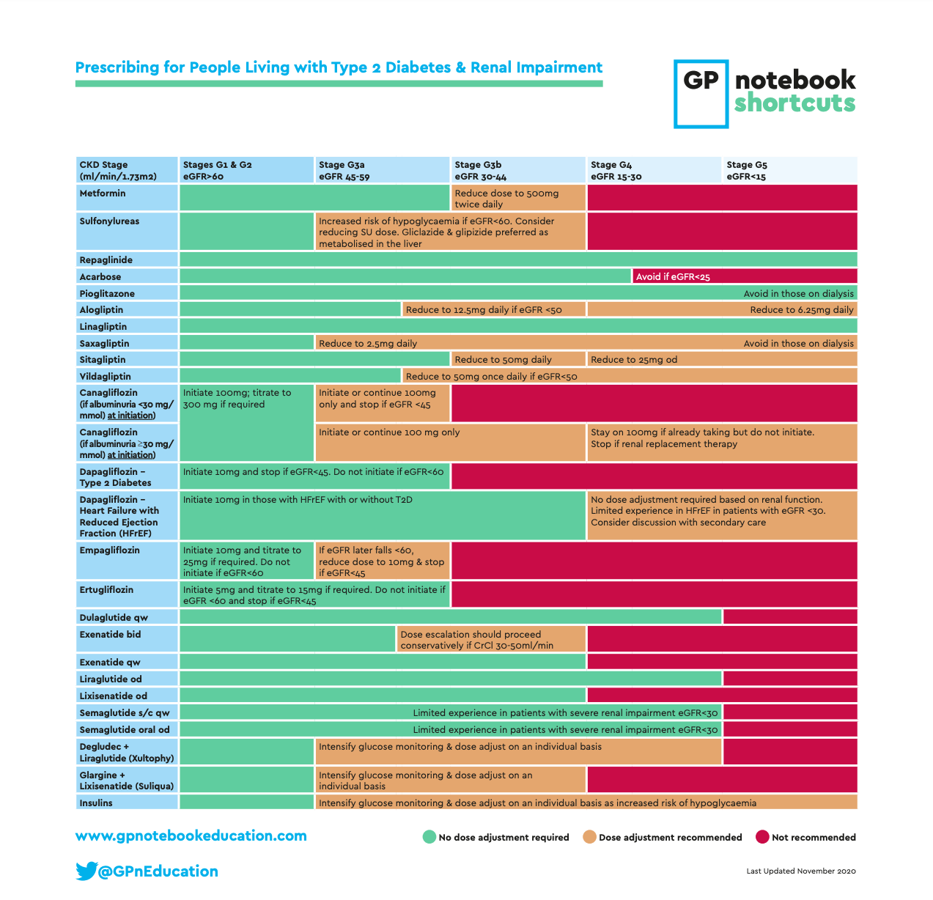

Slide 5
Sick Day Rules- SADMAN
SGLTl2i – flozins – dapa/empa/cana
Acei – prils
Diuretics
Metformin
Arb’s - sartans
Nsaids

Slide 6
If on any of the SADMAN drugs and have vomiting/and or diarrhoea then advise the person to:
-stop taking them as you are at risk of dehydration
- re-start when you are able to eat and drink normally for 1-2 days
- stay hydrated by drinking plenty of unsweetened drinks and eat little and often
This advise will help them avoid Acute Kidney Injury (AKI) and potential admission to hospital.

Slide 7
What is AKI?
Sudden deterioration in kidney function caused by dehydration, sepsis or heart attack.
Impact of AKI – from UK Kidney Association (UKKA) 2023 report
- 11,067 people per million within Coventry and Warwickshire
- 100,000 deaths in UK
- 32% occurred in people who were not in hospital at the time of the AKI
- Median length of stay was 11 days

Slide 8
Fournier’s Gangrene and SGLT2i
Necrotising fascititis of the perineum and genitalia which is life-threatening and was subject to a 2019 MHRA alert
It is an association with SGLT2i rather than causation and Type 2 diabetes is a risk factor
Extremely rare and affect 1 in 100,000 patients per year
If severe pain, tenderness, redness, swelling in the genital area and a temperature and tireness needs urgent referral to hospital

Slide 9
Diabetic Ketoacidosis (DKA) and SGLT2i
All flozins are contra-indicated in Type 1 diabetes
Incidence – 1 patient per 500 per year with 75% of cases 6 months after starting
Symptoms of DKA – excessive thirst and urination, nausea and vomiting, abdominal pain, difficulty breathing, ‘pear drop’ scent to breath
33% of cases happen with mildy increased blood glucose (<14) which can delay diagnosis

Slide 10
Who should we avoid prescribing SGLT2i for?
- past history of DKA
- eating disorder or very low carb carb (ketogenic diet)
- excessive alcohol consumption of intra-venous drug users
- pregnant, breastfeeding or of child-bearing age without contraception
- acutely unwell
- GFR lower than current licensing for the drug

Slide 11
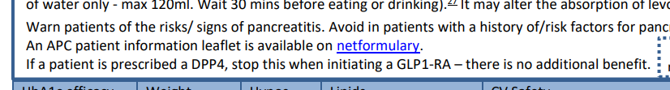
Patients on both GLP-1‘s and DPP4 (gliptins)
- search was created for patients on both and gliptin was stopped if obvious also on a GLP-1

Slide 12
Insulin safety
Access to blood glucose testing strips if on insulin or gliclazide
Prescibe by brand name – use G/T switch and ask patient what brand they use
DVLA guidance – need to test before a journey and be ‘5 to drive’ and test every 2 hours if on a long journey
If symptoms of a hypo while driving need to pull over to a safe location, move to passenger seat and take keys out of car
Bring blood glucose testing kit and both rapid acting glucose and long acting carbohydrates such as biscuits

Slide 13
Storage
Check storing at 2-8 degrees and not near back of fridge where it could get frozen
In-use vial – 28 days at room temperature (below 25 degrees) – consider adding date taken out of fridge
Are they using a new needle each time they inject?
Disposal – have they got a sharpsafe/sharpsguard yellow box?

Slide 14
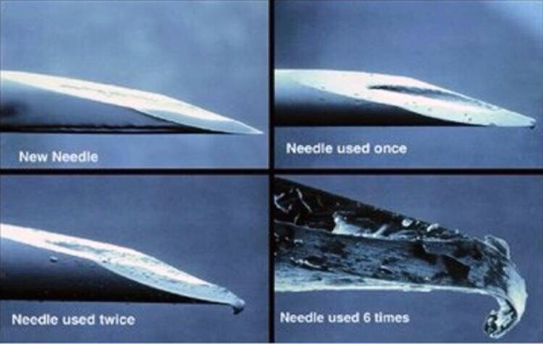

Slide 15
Lipohypertrophy
Occurs when a person injects insulin or another injectable into the same site too many times. Also includes people who use insulin pumps and use the same cannula insertion site.
An abnormal accumulation of fat which causes a delay in the absorption of insulin meaning it is not effective
Ask the person if they have any lumps where they inject? If so refer on to your diabetes specialist

Slide 16
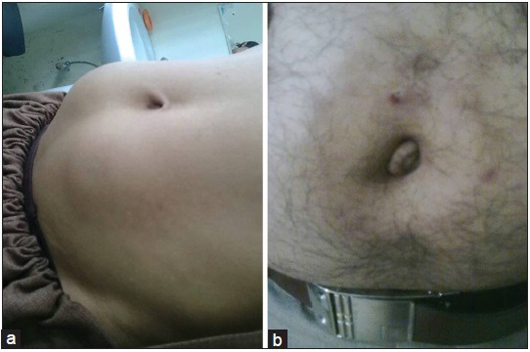

Slide 17
GLP’1’s and contraception
FSRH published guidance on 7th February 2025 and produced a patient information leaflet
- use contraception while on GLP-1’s
- if using Mounjaro (tirzepatide) and oral contraception switch to a non-oral method, or add a barrier method for 4 weeks after starting and for 4 weeks after each dose increase
- if side effects of severe vomiting and diarrhoea follow FSRH advice

Slide 18
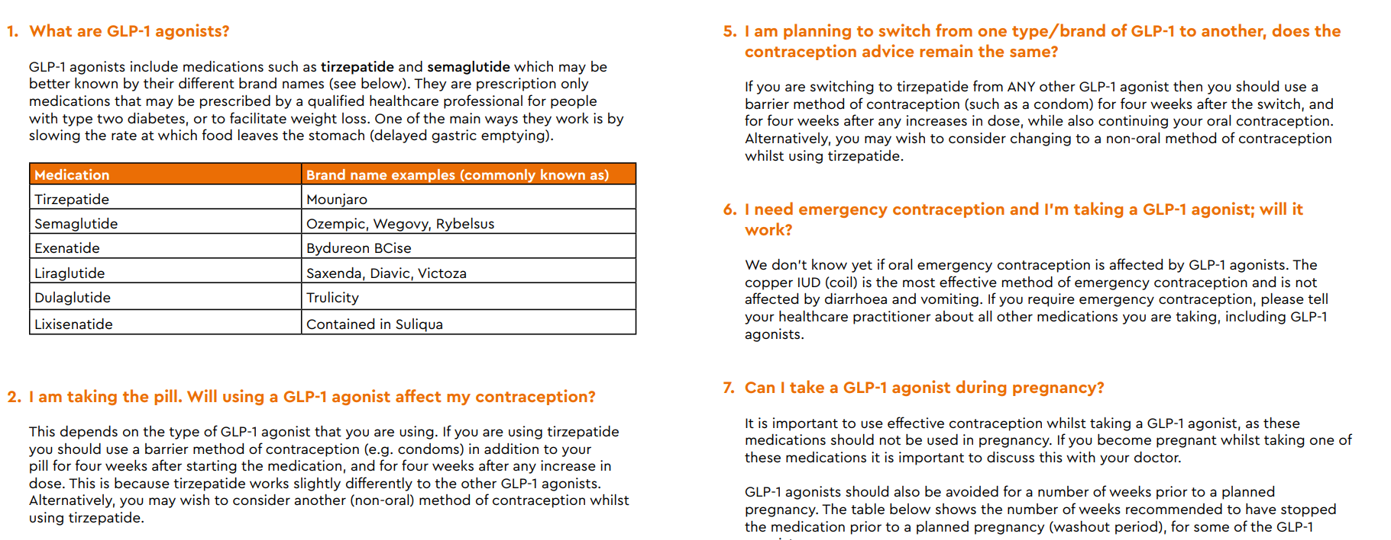

Slide 19
GLP-1’s and HRT
British Menopause Society (BMS) guidance on HRT and GLP-1 released 16th April 2025
Due to delay in gastric emptying and reduction in absorption of oral medications and potential for reduced endometrial protection
Progesterone – consider changing to Mirena/equivalent or increasing dose for 4 weeks on initiation and at each dose increase
Off label use of vaginal progesterone

Slide 20
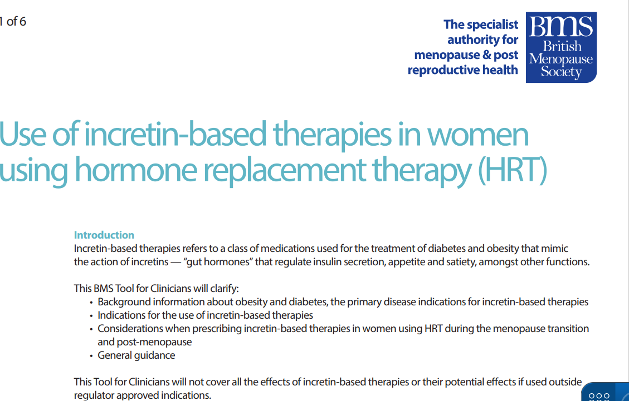

Slide 21
National Diabetes Audit as a tool to understand and improve monitoring
- open access, no log in required, core audit, diabetes in pregnancy,footcare, gestational diabetes
-you can look at the figures for your practice and consider how to improve response rates for the 8 KCP’s (Key Care Processes) – BP, weight/BMI, HbA1c, cholesterol, uACR, foot checks, smoking status, U&E’s

Slide 22
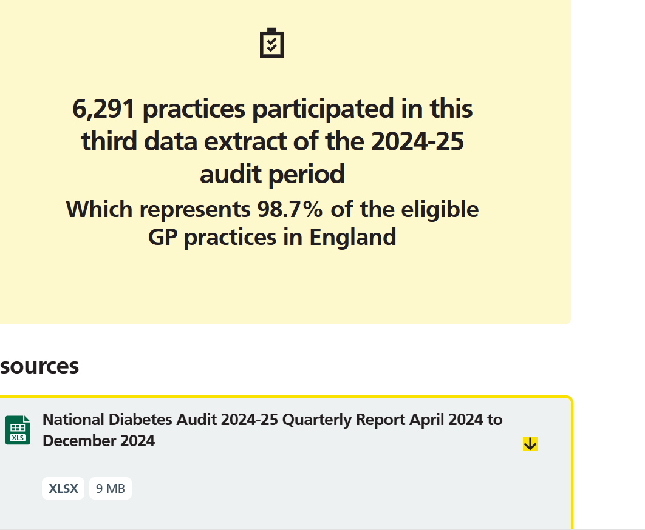

Slide 23
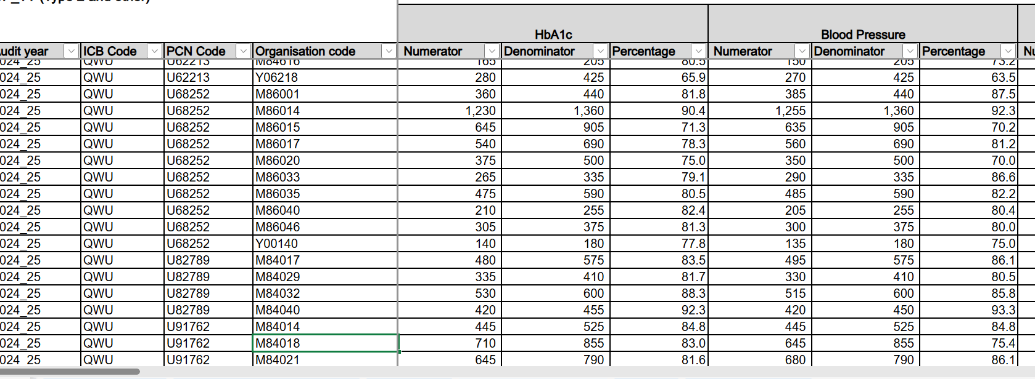

Slide 24
Project for Improving Diabetes Care
- birthday month review process and a letter is sent inviting the person living with diabetes for a review
- if no response a 2nd letter is sent a month later
- audit of non-responders from Jan to Mar 2025
- 40 patients had not responded to the 2 letters sent out
- I called and if no answer sent a text/email if available and was able to book approx. 40% into the required appointments
- ran a search for those coded as housebound and with Type 2 diabetes and have arranged a home visit for 7 people in the next 2 months

