Slide 1
Coventry and Warwickshire Area Prescribing Committee Formulary: Diabetes
Fazila Chunara
Jenny Cronin
Medicines Optimisation Pharmacists, CWICB

Slide 2
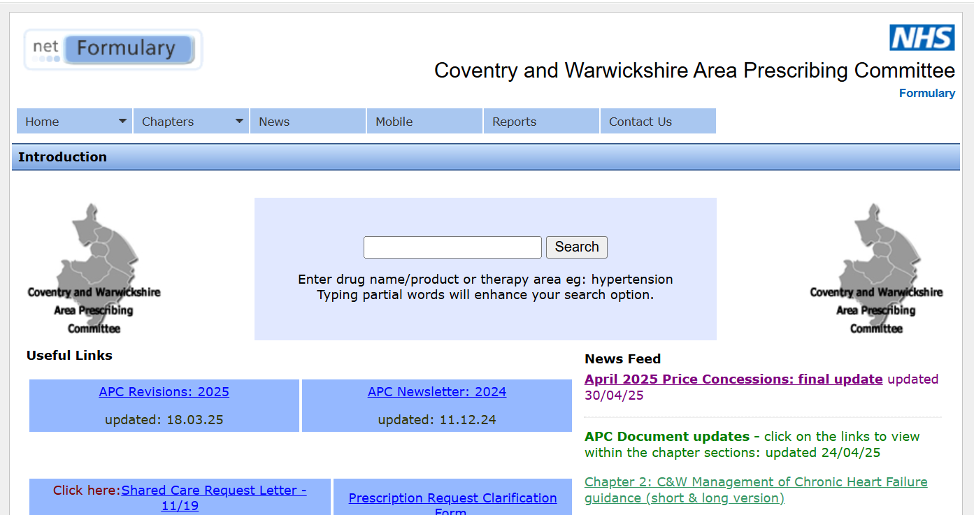
NetFormulary Website
https://www.covwarkformulary.nhs.uk/

Slide 3
Diabetes Resources Available
Type 2 Diabetes Treatment Algorithm – CG014
Insulin Guidelines for Type 1 and Type 2 Diabetes in Adults – CG042
GP Prescribing Guide for Paediatric Patients with Type 1 Diabetes – CG045
Patient information leaflet: SGLT2i – RD050
Patient information leaflet: injectable GLP1-RA - RD051
Tirzepatide (Mounjaro®) Safety Spotlight – RD054
Needles for Diabetes Medicines – RD047
Blood Glucose Testing Strips PPL – RD024
Blood Glucose Self-Monitoring Guideline – RD003

Slide 4
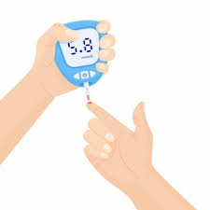
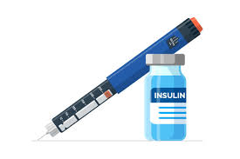
Test Your Knowledge Quiz

Slide 5
Question 1:
What size needle is recommended for patients on insulin?
4mm
5mm
6mm

Slide 6
Question 2:
Which of these test strips are on our formulary?
GlucoFix Tech
FreeStyle Optium
Contour Plus
Contour Next
CareSens Dual

Slide 7
Question 3:
How many doses are there is each Tirzepatide (Mounjaro) pen?
1
30
4
56

Slide 8
Question 4:
A patient needs a sharps bin if they are prescribed these items – true or false?
Insulin
Injectable GLP
Blood glucose test strips & lancets
CGM sensors

Slide 9
Question 5:
For which of these patients would it be appropriate to prescribe safety needles on FP10?
An 8 year old patient with T1DM
A patient living in a nursing home
A patient that the District Nurses are visiting to administer insulin

Slide 10
Question 6:
Which of these patients may need to self-monitor blood glucose?
A patient with Type 1 Diabetes on basal-bolus insulin
A patient with Type 2 Diabetes on metformin, dapagliflozin and semaglutide
A patient with Type 2 Diabetes on basal insulin only
A newly diagnosed patient with Type 2 Diabetes treated with diet alone
A patient with Type 2 diabetes on metformin and gliclazide
A lorry driver with Type 2 Diabetes who is on metformin and pioglitazone
A patient with gestational diabetes who is not on any medication

Slide 11
Question 7:
Which of these patients are eligible for CGM?
A patient with Type 1 diabetes on multiple daily insulin doses
A patient with Type 2 diabetes on gliclazide, empagliflozin and dulaglutide
A patient with Type 2 diabetes on multiple daily insulin doses and frequent hypoglycaemia
A patient with Type 2 diabetes on basal insulin only

Slide 12
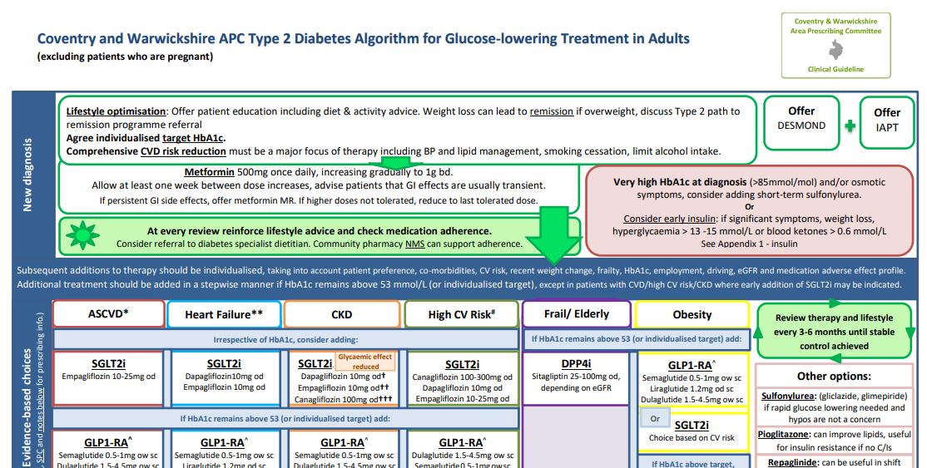
Type 2 Diabetes treatment algorithm – CG014 - Summary algorithm - Useful additional information (e.g. HbA1c targets, remission) - Information on medication classes - Referral criteria - Appendix - insulin
Notes:
Also mention insulin guidelines
Guidance found at APC CG014

Slide 13
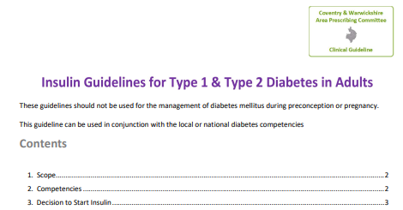
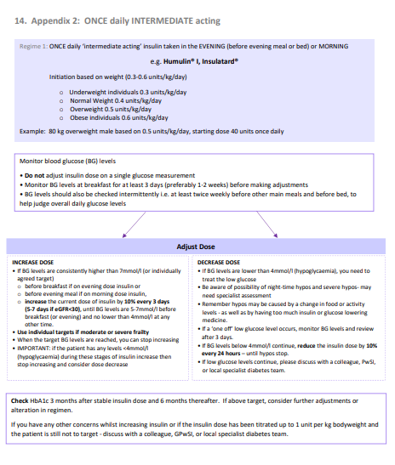
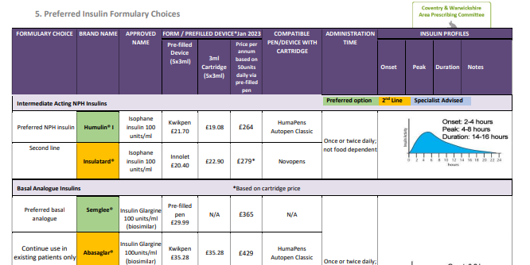
Insulin Guidance – CG042 - Insulin regimes - Formulary choices - Treatment of hypoglycaemia - Dosage adjustment for different regimes.
Notes:
Also mention insulin guidelines
Guidance found at APC CG042 and also mentioned in diabetes treatment algorithm at CG014

Slide 14
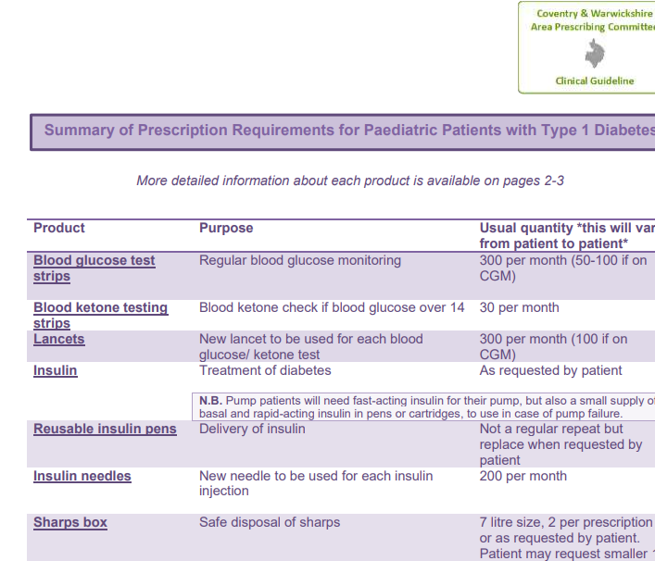
GP Prescribing Guide for Paediatric Patients with Type 1 Diabetes – CG045
- Medicines/ products that patients will need on prescription
- Usual quantities required
- Explanation for each medication/product
Notes:
Also mention insulin guidelines
Guidance found at APC CG014

Slide 15
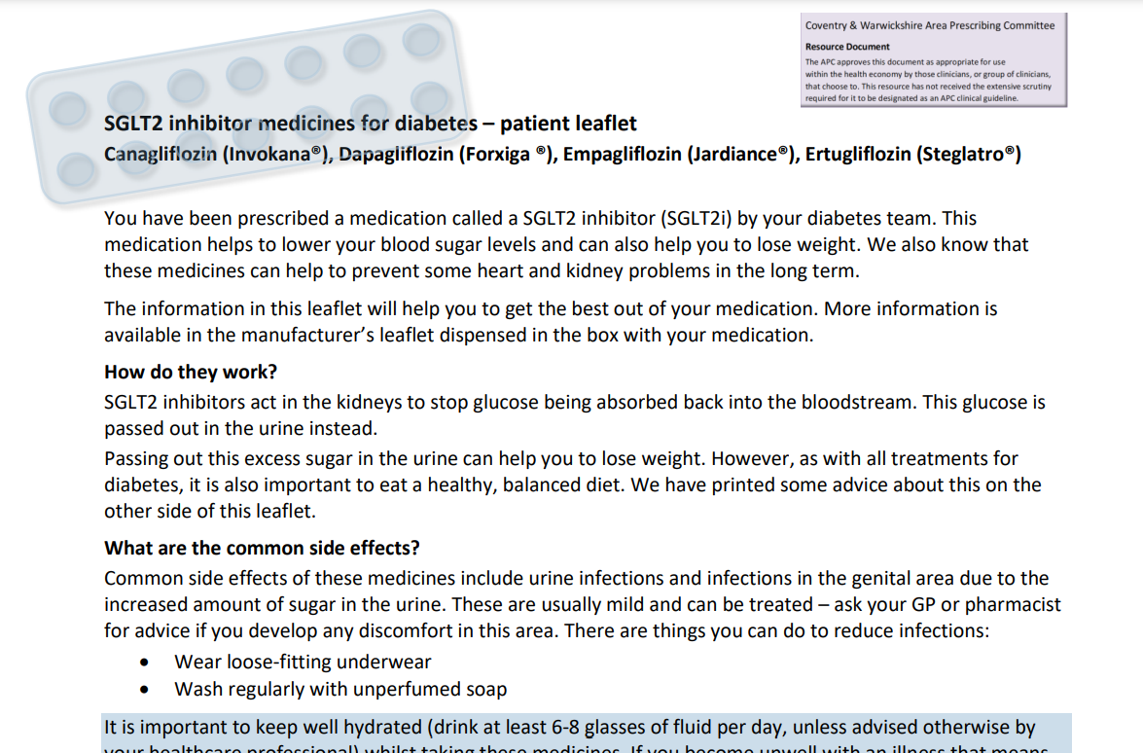
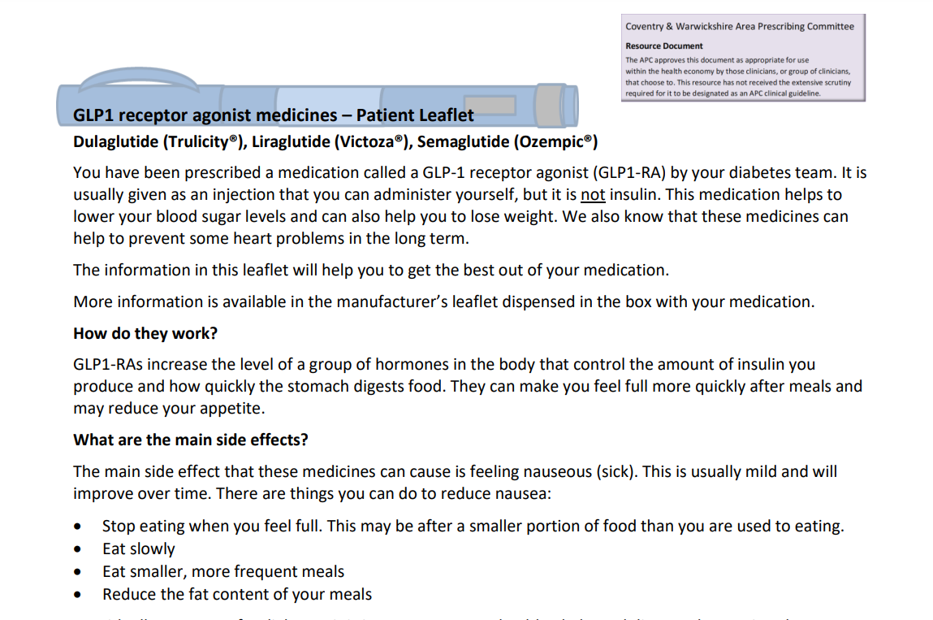
Patient Information Leaflets: SGLT2i and injectable GLP-1 RA
Notes:
SGLT2i leaflet includes advice on DKA and Fournier’s gangrene so may help with CQC requirements

Slide 16
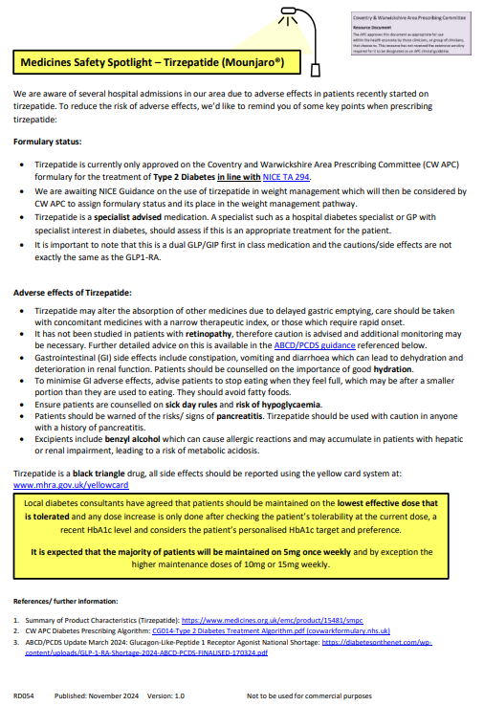
Tirzepatide (Mounjaro®) Safety Spotlight
- Formulary status
- Recommended dose
- Adverse effects, including counselling points
Specialist Advised for treatment of Type 2 Diabetes only. Not yet approved by APC for weight loss alone – awaiting obesity pathway.
Local specialists have recommended that the most cost-effective maintenance dose of tirzepatide for Type 2 Diabetes is 5mg once weekly. Doses above this show only marginal improvement in glycaemic control.
Each tirzepatide pen administers four weekly doses so ONE pen is required each MONTH
Notes:
GIP - glucose-dependent insulinotropic polypeptide
GLP - glucagon-like peptide-1 receptor agonist
Be aware of possible delayed absorption of other medications due to delayed gastric emptying esp those that require rapid onset of action. Monitor where possible especially during initiation and following any dose changes.
2 indications with certain criteria in place eg certain BMI/alongside physical exercise and calorie counting diet.
Formulary status is specialist advised therefore can be recommended by specialist and primary care asked to prescribe.
Currently with CWICB, only approved for treatment of T2DM and not for weight management.
Some of the different GLP-1’s will have different numbers of doses per pen, so always double check with BNF/SPC if unsure.

Slide 17
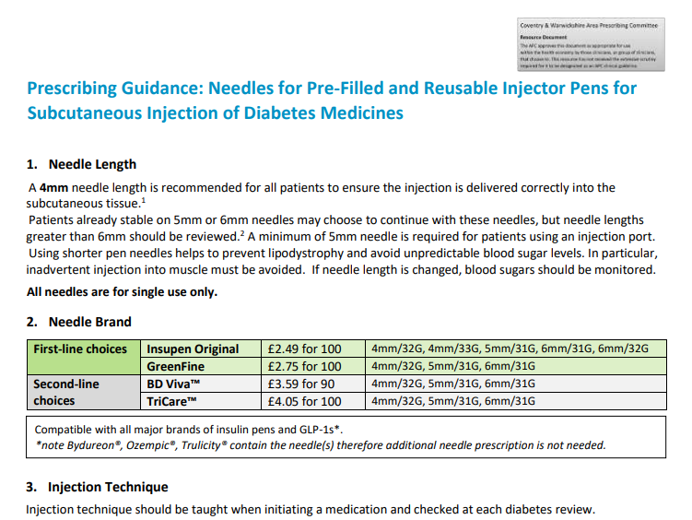
Needles for Diabetes Medicines - RD047
Formulary choices – Insupen Original or GreenFine
Advice on needle length – 4mm
Injection technique key points
Safe disposal of sharps
Sharpsafe devices
Notes:
NHSE – all needles should be <£5 per 100
Importance of appropriate needle length and reinforcing injection technique at review. Ask about/ check for lipos. New needle for every injection.
Sharpsafe devices generally for paediatrics and patients under the care of district nursing team

Slide 18
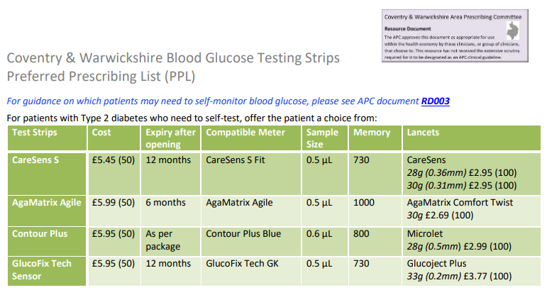
Blood glucose testing strips PPL - RD024
Lists preferred meters and compatible strips and lancets
In line with NHSE commissioning guidance
Includes contact details for ordering meters
Notes:
Run through blood glucose vs glucose and ketone meters
Industry switches
Current status of FP10 CGM
Back up meter with CGM

Slide 19
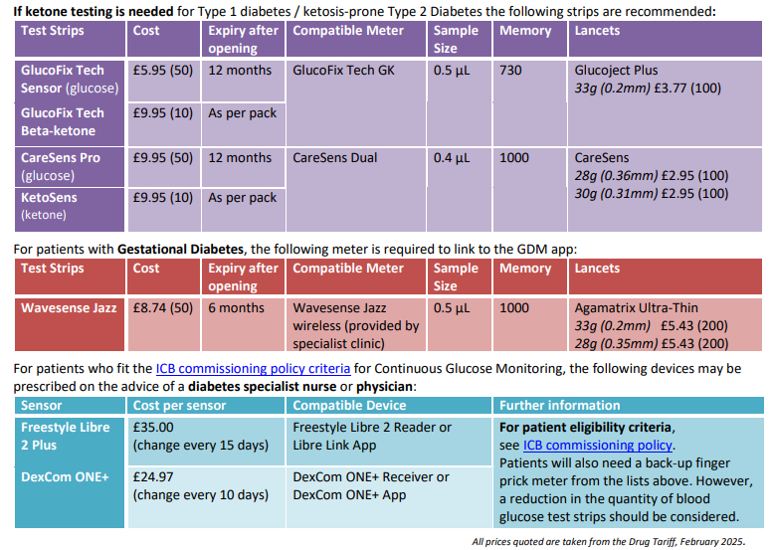
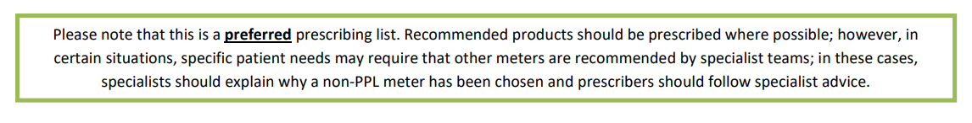
Notes:
Preferred list disclaimer

Slide 20
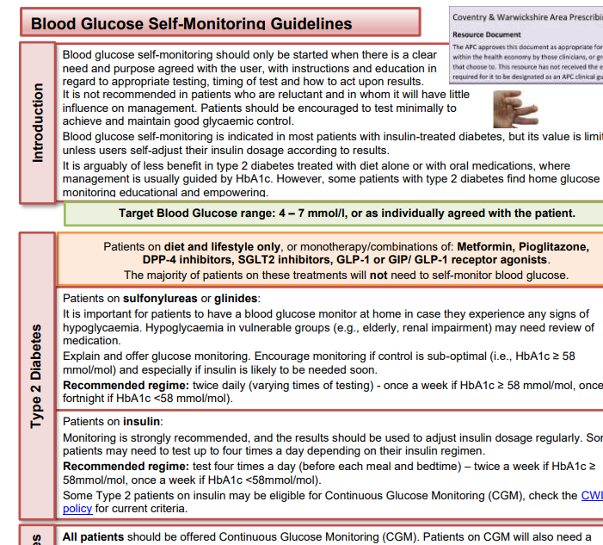
Blood Glucose Self-monitoring Guideline - RD003
Advice on frequency of blood glucose testing for different patient groups
DVLA advice
Tips when assessing self-monitoring
Currently being updated to include advice on CGM
Notes:
Important that patient knows purpose of testing and what to do with results.
When to test – T2DM, usually before meals, or 2 hours after meals – sugars should have returned to target range.
Test more frequently when unwell.
Target range – may need to be individualised
Document readings on an app or in a book and bring them to diabetes review
If recurrent hypo or hyper seek advice
Wash hands before test, new lancet for each test
Sharps box

Slide 21
Why use SMBG?
SMBG can be a really useful tool in managing diabetes, but it must have a clear purpose and patients must know how to act upon their readings.
We would usually recommend SMBG for:
All patients with Type 1 Diabetes (usually CGM plus backup meter)
Patients with Type 2 Diabetes on medicines that may cause hypoglycaemia (insulin, sulfonylureas or repaglinide), especially if they are drivers.
All patients with gestational diabetes
Patients may need SMBG short term:
When newly diagnosed, for educational purposes to understand the effect of different foods on blood sugars and adjust diet.
When taking high doses of oral corticosteroids.

Slide 22
Frequency of monitoring
The guidelines give recommended regimes for monitoring for different patient groups:
Type 2 Diabetes:
On sulphonylurea - twice daily (varying times of testing) - once a week if HbA1c ≥ 58 mmol/mol, once a fortnight if HbA1c ≥ 58 mmol/mol
On insulin - test four times a day (before each meal and bedtime) – twice a week if HbA1c ≥ 58mmol/mol, once a week if HbA1c ≥ 58 mmol/mol. Patients who are self-adjusting insulin may need to test every day.
Type 1 Diabetes:
Patients who are not using CGM will need to test glucose up to 8 times per day.
Gestational Diabetes
Self-monitor blood glucose 4-10 times per day, irrespective of treatment.

Slide 23
Frequency of monitoring (cont.)
Times when increased testing may be needed:
• During pregnancy or planning pregnancy.
• During illness or changes in therapy.
• If lifestyle changes or during prolonged fasting.
• If hypoglycaemia is more frequent and/or hypoglycaemic unawareness
Driving – DVLA guidance
You must be able to recognise and self-treat your hypos.
All drivers on insulin or sulfonylureas or glinides must test blood glucose within 2 hours before driving and every 2 hours whilst driving.
Group 2 drivers (bus/lorry) on these medicines are additionally required by law to monitor blood glucose levels at least twice daily (even if not driving).
CGM readings can only legally be used for the purposes of driving for Group 1 drivers. Group 2 drivers must use finger-prick testing. Patients using CGM must also carry a finger-prick meter to confirm readings if they experience a hypo.

Slide 24
When to test blood ketones?
Diabetic ketoacidosis is a medical emergency.
Some meters will have the ability to check glucose and ketones, whereas others will only test glucose.
Ketones are usually tested using a different strip; the meter detects the type of test automatically.
Patients with Type 1 Diabetes, or patients with Type 2 Diabetes at high risk of ketosis, should test for ketones when sugars are high (usually over 14 but patients may have individual advice)
Blood ketone level
< 0.6 | Normal
0.6 – 1.5 | Repeat in 2 hours
1.6 - 3 | At risk of DKA; seek advice
> 3 | Emergency treatment
Notes:
Ketone bodies (acetoacetate and 𝜷β-hydroxybutyrate) are produced in the liver from the breakdown of fatty acids as a source of energy during fasting, exercise and insulin-deficient states, e.g. in intercurrent illness in people with diabetes. The presence of ketones in urine or blood may signify a risk of diabetic ketoacidosis (DKA).

Slide 25
How to test: patient advice
Usually, the most beneficial time to test is just before a meal or 2 hours after a meal. Always test if you have hypo symptoms.
Wash hands with soap and water and dry thoroughly.
Use new lancet in your lancing device to prick the side of your middle, ring or little finger.
Use a different finger/area each time.
Dispose of the used lancet in a sharps bin.
Consider using the app linked to your meter to track results.
Patients should have an annual review of SMBG to check skills, frequency and timing of testing, interpretation of results, appropriate meter.
Notes:
Don’t use wet wipes as the glycerine in them can affect the test result. Make sure your hands are warm so it’s easier to get blood and won’t hurt as much.

Slide 26
Quantities of Strips/Lancets
Blood Glucose Testing Strips
Treatment Regime | Frequency of Testing* | Number of Tests in 28 Days | Approx. Number of Strips/Script (50 strips/pack)** | Script Duration
Type 2 Diabetes on SU/Glinide | BD Once/week or once/fortnight | 4-8 | 50 | 6-12 months
Type 2 Diabetes on Insulin | QDS once/week or QDS twice/week | 16-32 | 50 | 1-3 months
Type 1 Diabetes | Up to 8 times/day | 224 | 250 | 1 month
Gestational Diabetes | Up to 4-10 times/day | 112-280 | 150-300 | 1 month
Lancets
Treatment Regime | Frequency of Testing* | Number of Tests in 28 Days | Approx. Number of Lancets/Script (100 lancets/pack)** | Script Duration
Type 2 Diabetes on SU/Glinide | BD Once/week or once/fortnight | 4-8 | 100 | 12-24 months
Type 2 Diabetes on Insulin | QDS once/week or QDS twice/week | 16-32 | 100 | 3-6 months
Type 1 Diabetes | Up to 8 times/day | 224 | 300 | 1 month
Gestational Diabetes | Up to 4-10 times/day | 112-280 | 200-300 | 1 month
*Frequency of testing can increase in certain circumstances
** Numbers are approximate and some variation in testing may require more/less strips being prescribed
Notes:
Mention that those on CGM should still get a meter and some test strips infrequently

Slide 27
Continuous Glucose Monitoring (CGM) Eligibility Criteria
The ICB has a policy on who can be prescribed CGM on FP10 (available on ICB website)
CGM devices currently on our formulary are Libre 2 Plus and Dexcom One+.
Patients will also need a backup finger-prick meter. Check quantities of test strips – usually 50 every 2-3 months.
All patients with Type 1 Diabetes should be offered CGM.
Adults with type 2 diabetes are eligible if they are prescribed more than one insulin injection a day, and meet one or more of the following criteria:
with a need, condition, or disability (including a learning disability or cognitive impairment) that means they cannot engage in monitoring their glucose levels by capillary blood glucose monitoring.
who would otherwise be advised to self-monitor at least 8 times a day.
with recurrent hypoglycaemia - frequent events of hypoglycaemia that occur each week or at least twice per month and have an impact on quality of life.
with one or more episodes of severe hypoglycaemia in the preceding 12 months that required assistance from another person to treat.
with impaired hypoglycaemia awareness
patients who are pregnant. (CGM to be reviewed after delivery and stopped if patient no longer meets eligibility criteria).

Slide 28

How Well Did You Do?

Slide 29
Question 1:
What size needle is recommended for patients on insulin?
4mm
5mm
6mm

Slide 30
Question 2:
Which of these test strips are on our formulary?
GlucoFix Tech
FreeStyle Optium
Contour Plus
Contour Next
CareSens Dual

Slide 31
Question 3:
How many doses are there is each Tirzepatide (Mounjaro) pen?
1
30
4
56

Slide 32
Question 4:
A patient needs a sharps bin if they are prescribed these items – true or false?
Insulin
Injectable GLP
Blood glucose test strips & lancets
CGM sensors

Slide 33
Question 5:
For which of these patients would it be appropriate to prescribe safety needles on FP10?
An 8 year old patient with T1DM
A patient living in a nursing home
A patient that the District Nurses are visiting to administer insulin

Slide 34
Question 6:
Which of these patients may need to self-monitor blood glucose?
A patient with Type 1 Diabetes on basal-bolus insulin
A patient with Type 2 Diabetes on metformin, dapagliflozin and semaglutide
A patient with Type 2 Diabetes on basal insulin only
A newly diagnosed patient with Type 2 Diabetes treated with diet alone
A patient with Type 2 diabetes on metformin and gliclazide
A lorry driver with Type 2 Diabetes who is on metformin and pioglitazone
A patient with gestational diabetes who is not on any medication

Slide 35
Any questions?
fazila.chunara@nhs.net
jennifer.cronin@nhs.net

