Slide 1
Diabetes UK & Diabetes week 2025

Slide 2

Our theme for diabetes week 2025
A focus on essential care
Regular health checks – the 9 care processes – are a key part of living with diabetes. Diabetes Week is about showcasing the reality of living with diabetes, and the reality is that 1 in 3 people aren’t getting all 9 care processes.
So we want to shine a line on these checks this Diabetes Week, the importance of getting them, and acknowledge some of the reasons people might not be. We want to empower people to feel more in control of their health – to motivate as well as educate.
The health checks as an essential part of your overall physical and emotional wellbeing – acknowledging some of the barriers that many people face in attending appointments but hopefully giving them the info, support and confidence to take steps to overcome them.

Slide 3
Getting essential care right
Our ambition:
What do we want to achieve?
An improvement from the 37% of people receiving all nine care processes (NDA 2021-22) to 60% by the end of 2025, with a further rise to 90% by 2028.
Why does our essential care ambition focus on care processes?
They are the building blocks to better overall care, correlating with improved diabetes outcomes, reduced mortality and complications, meeting treatment targets, and better patient reported outcomes.
There is still lower uptake of care processes in areas of deprivation and lower uptake in younger age groups (under 40) vs older age groups for type 2.
There are large variations in completion of care processes between different practices and in PCNs/ICBs/health boards.

Slide 4
Diabetes UK Ambitions - Prevention
Support local health systems to identify current challenges to referrals and support those at high risk into diabetes prevention programmes, including what is needed to reduce the risk of developing T2 after GDM.
Increase HCP awareness of increased risk of type 2 diabetes after GDM.
Lobby UK and devolved governments and parliaments for robust new policies implemented that create healthier environments, and to contiune/develop diabetes prevention programmes.
Know Your Risk product improvements and journey development, including KYR customer journey development, and with clinical health systems.

Slide 5
Diabetes uk ambitions - Reaching newly diagnosed
Influence and educate systems so they encourage their primary care Healthcare Professionals to refer to us and upskill staff to deliver better diagnosis care.
Develop strategic partnerships aligned with our Tackling Inequality and Stigma ambitions.
Lobby Westminster and devolved Governments to improve care at diagnosis, particularly for target audiences.
Partner with Government to introduce direct referral to us from the NHS in England. Explore in other nations.
Expand work with digital health companies (e.g. iPlato, Emis, Ardens) to enable the NHS to signpost to us at the point of diagnosis via text/app.

Slide 6



Resources
What care to expect leaflets
Easy read guide – reprinted in English and now available in 10 languages
Fold out Z cards “my diabetes care to expect”
Posters – “Your diabetes check-ups matter”
Digital resources for both Diabetes Week and essential care
Learning Zone health checks course (online)

Slide 7
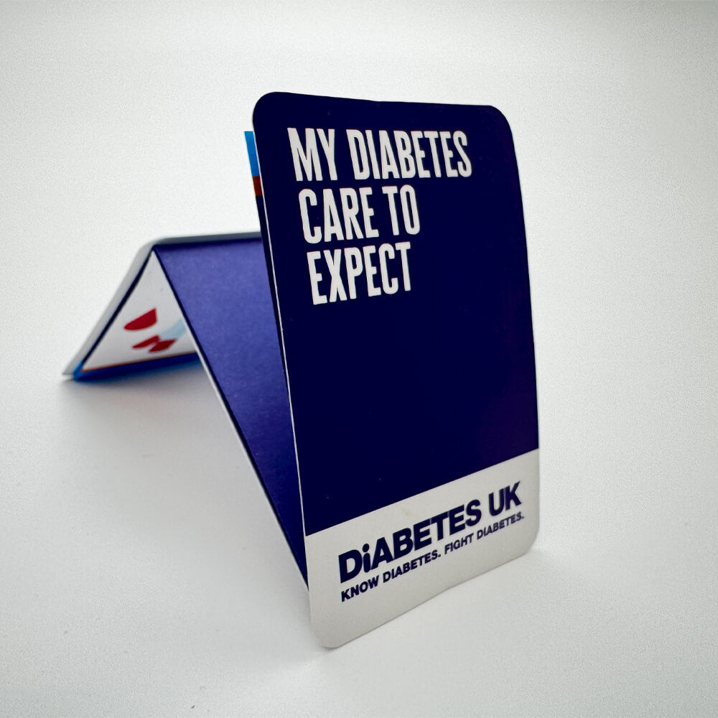
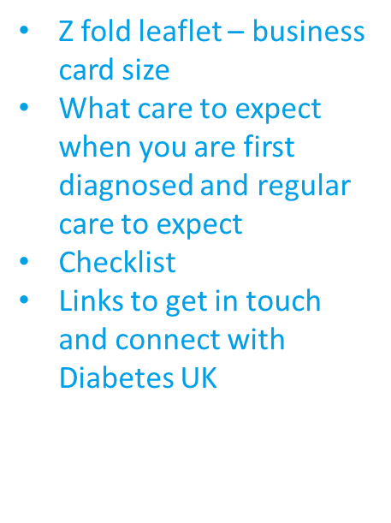
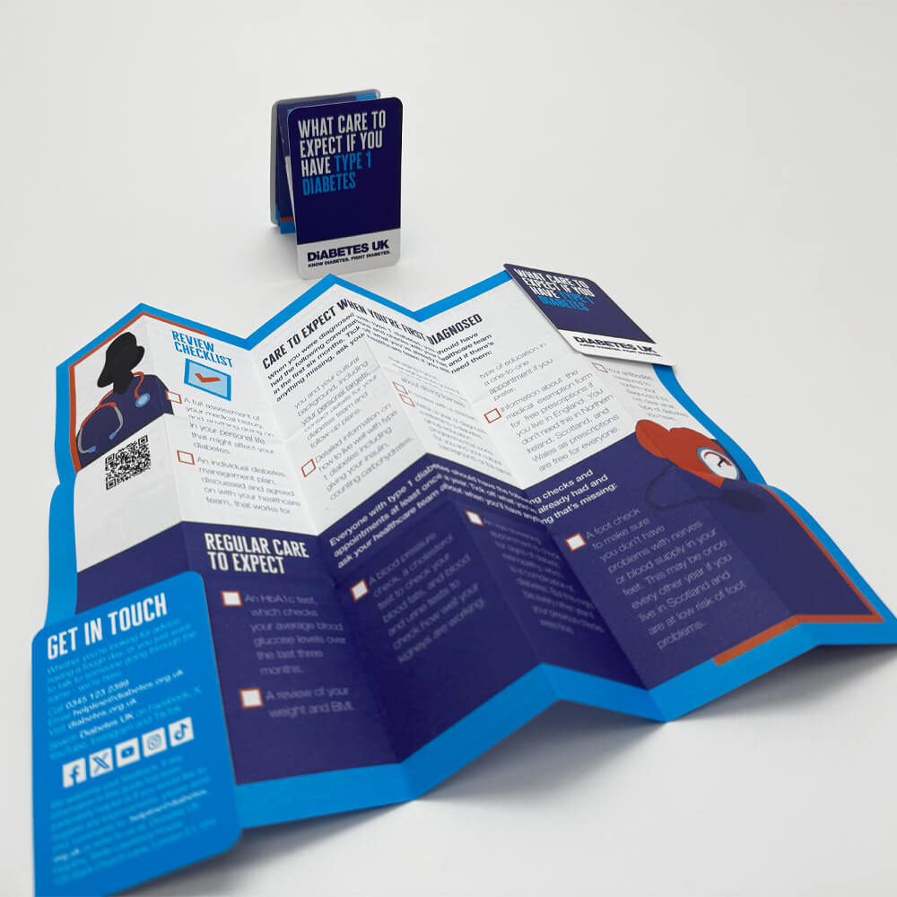
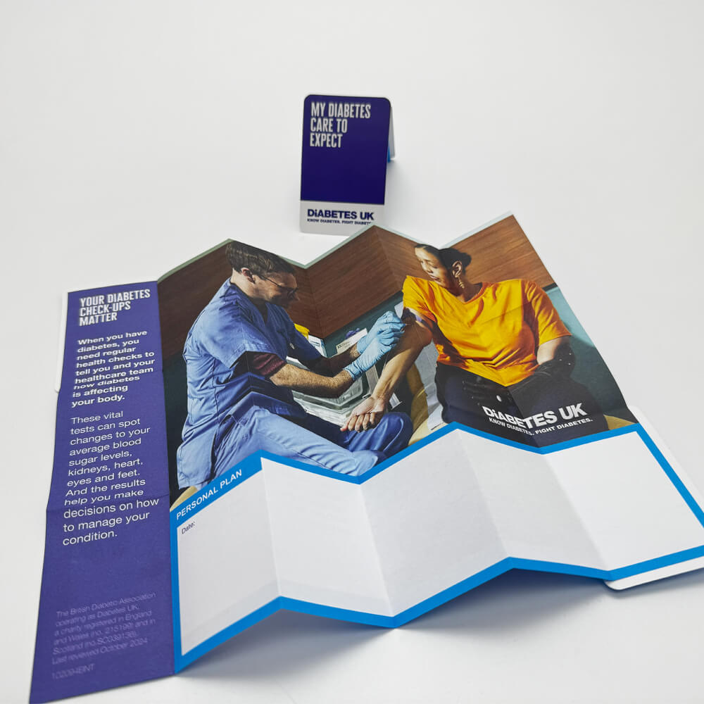

Slide 8

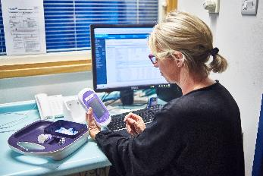

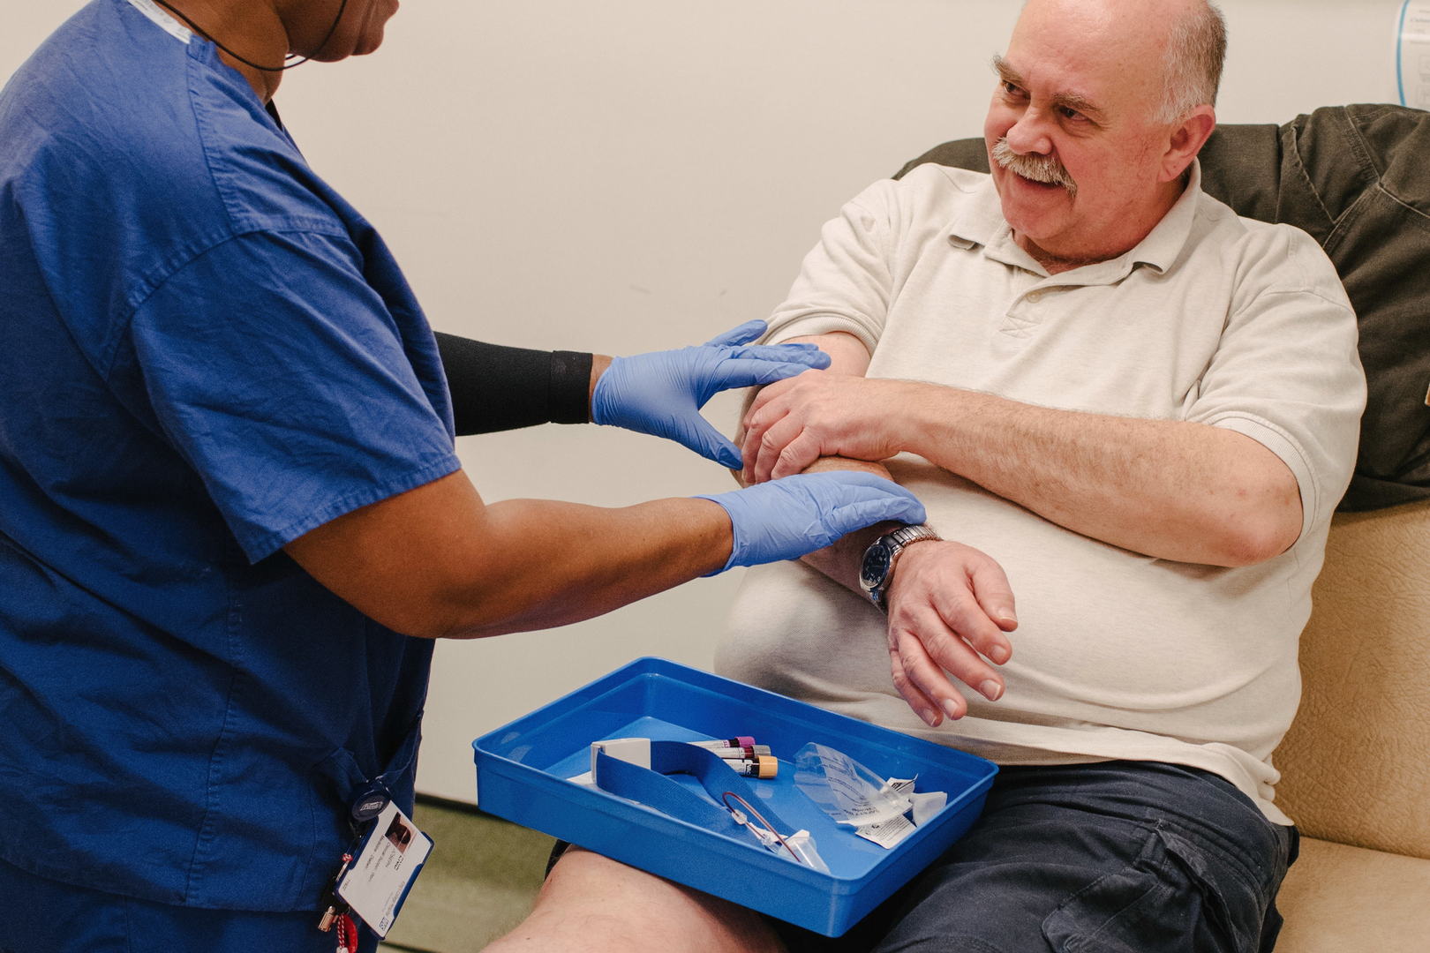
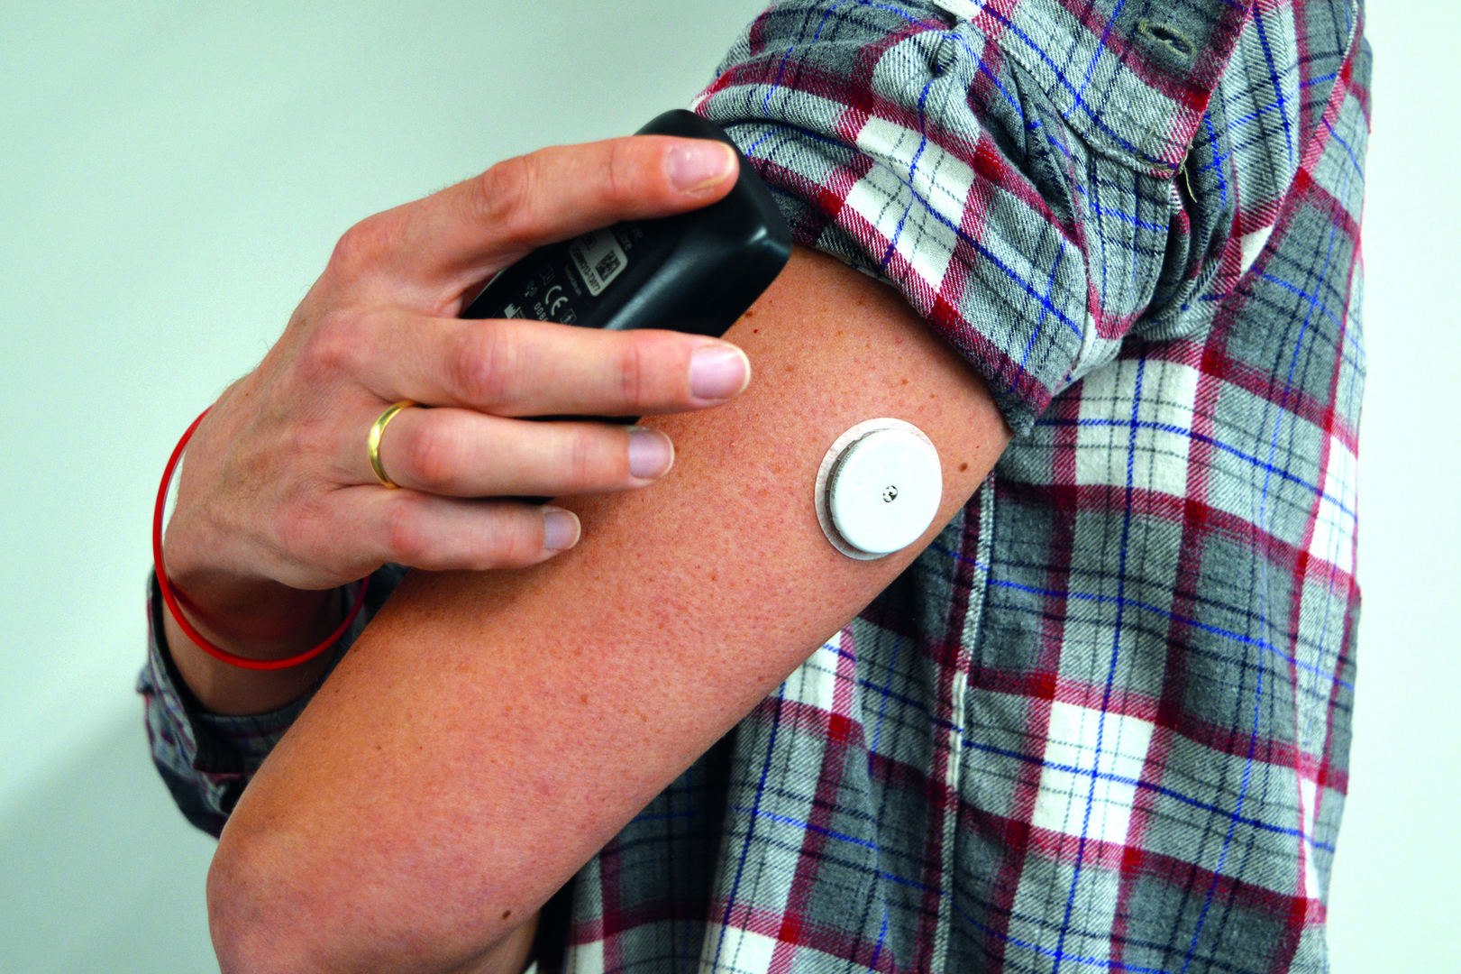
Diabetes UK CPD
cpd.diabetes.org.uk
Take our free, online training modules to improve and refresh your knowledge:
Emotional wellbeing
Understanding diabetes
Remission
Medicines and Treatments
Technology
Increases diabetes knowledge amongst HCPs so they can increase quality and confidence when providing diabetes care.
Empower HCPs to have quality conversations with patients, understanding the impact that diabetes has on emotional health and encouraging self-management
Notes:
Diabetes UK CPD is our newly refreshed training module for healthcare professionals. It is freely available to all and aimed at supporting non-specialist healthcare professionals working with adults living with type 1 and type 2 diabetes.
Our first module, Diabetes and Emotional Wellbeing, will improve healthcare professionals' knowledge and support them to confidently talk about emotional wellbeing with people with diabetes.

Slide 9


Help is at hand
Learning Zone is our award-winning diabetes self-management tool for people with diabetes.
Sign in to explore the tool for yourself including My Goals, our new personalised 6-week courses
diabetes.org.uk/learn
In 2024 Learning Zone reached 180,000 users
Notes:
Learning Zone is our online learning platform for people living with diabetes.
You can log in as a HCP to use some of the content before recommending it to people with diabetes.
It is free, easy to use and gives the user personalised content based on their diabetes type, treatments and demographic.
It can be used at any time in a person's diabetes journey, wherever they are. It can be accessed from a desktop, tablet or mobile and is available all day, every day.
Learning Zone features content for people with diabetes created by people living with diabetes.
It combines evidence-based medical advice with real patient lived experiences to deliver a unique learning experience.

Slide 10

Date: 11th November 2025 Time: 10.00am - 4:00pm Where: Online We have an exciting programme lined up for our 14th Diabetes in Pregnancy UK Conference. This is open to all healthcare professionals with an interest in diabetes and pregnancy. Please register your interest by emailing Midlands@diabetes.org.uk and we will send you further details.

Slide 11




Diabetes UK Helpline
Get specialist information and advice on all aspects of living with diabetes. Call us for answers, support or just to talk to someone who knows about diabetes.
Our helpline number is 0345 123 2399. It is a dedicated diabetes helpline for all people with diabetes, their family or friends, and people who are worried they might be at risk.
https://www.diabetes.org.uk/about-diabetes/type-1-diabetes

Slide 12



Thank you
Email:
Peter.Shorrick@diabetes.org.uk
Brioni.Maker@diabetes.org.uk
Gursharan.Kaur@diabetes.org.uk
Website:
diabetes.org.uk/professionals
Twitter:
@DiabetesUKProf
Notes:
To find out more about the things we’ve talked about, visit the webpages listed throughout the presentation, or visit the Diabetes UK virtual exhibition.
To keep up to date with us, follow us on twitter at @DiabetesUKProf and if you have any questions about how Diabetes UK can support you and people with diabetes, you can get in touch with us at healthcare@diabetes.org.uk

