Slide 1


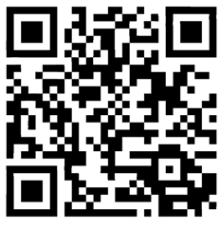
Save the Date
Tuesday, 17th September 2024 09:00 – 17:00
Register using QR code
6th National Advanced Practice Conference
Clinical Sciences Building, UHCW NHS Trust
Clifford Bridge Road, Coventry CV2 2DX
*The cost for non UHCW NHS Trust delegates to attend the conference including lunch and refreshments is just £50.00 each.
(This is non-refundable once a place has been reserved)

