Slide 1


Pharmacy Technician medication reviews

Slide 2

Case Study – ‘Mavis’
Repeat Drug | Dosage | Quantity
Alendronic acid 70mg tablets | One To Be Taken on The Same Day Each Week first thing in morning with large glass of water and remain upright (sit/stand) for at least 30minutes. Do not eat/drink or take any other medications for 30 minutes after dose | 4 tablet
Apixaban 5mg tablets | One To Be Taken Twice A Day (until reviewed in haematology clinic) | 56 tablet
Atorvastatin 20mg tablets | One To Be Taken Each Day | 28 tablet
Beclometasone 100micrograms/dose / Formoterol 6micrograms/dose inhaler CFC free | Two Puffs To Be Inhaled Twice A Day | 1 x 120 dose
Calcichew D3 Forte chewable tablets (Forum Health Products Ltd) | one twice daily- chew these | 60 tablet
Carbimazole 10mg tablets | One To Be Taken Each Day | 28 tablet
Macrogol compound oral powder sachets NPF sugar free | Dissolve the contents of One sachet in Half a glass (125ml) of water and Take Twice a day | 60 sachets
Memantine 20mg tablets | One To Be Taken Each Day | 28 tablet
Metformin 500mg tablets | Two To Be Taken Twice A Day | 112 tablet
Paracetamol 500mg tablets | Two To Be Taken Three Times A Day | 168 tablet
Propranolol 10mg tablets | Two To Be Taken Twice A Day | 112 tablet
Senna 7.5mg tablets | One Or Two To Be Taken At Night | 60 tablet
Sertraline 100mg tablets | One To Be Taken Each Day | 28
Variable use repeat drug | Directions | Quantity
Dansac Easispray adhesive remover 083-01 | Use As Directed | 250ml
Hydroxocobalamin 1mg/1ml solution for injection ampoules | One every three months | 1 ampoule
Novalife 1 Colostomy bag midi 902-10 cut to fit 10mm-55mm/70mm clear | As directed | 150 device
Nutilis Clear powder (Nutricia Ltd) | Level as advised by SALT. Make up as manufacturer's instructions. | 350 gram
Salts Aloe ring SAR25 25mm (Salts Healthcare | as needed | 30 device
Residential Home – 83 years old
Basal cell carcinoma
Colostomy
COPD
Dementia
Osteoporosis
Pulmonary Embolism
Pure hypercholesterolaemia
Thyrotoxicosis
Type 2 Diabetes
Acute Drug | Dosage | Quantity
Comirnaty Original/Omicron BA.4-5 COVID-19 mRNA Vaccine 15micrograms/15micrograms/0.3ml dose dispersion for injection multidose vials (Pfizer Ltd) | 0.3 ml Intramuscular | 0.3 ml
COVID-19 Vaccine VidPrevtyn Beta (CoV2 preS dTM monovalent B.1.351 [recombinant adjuvanted]) 5micrograms/0.5ml dose solution and emulsion for emulsion for injection multidose vials (Sanofi) | 0.5 ml Intramuscular | 0.5 ml

Slide 3
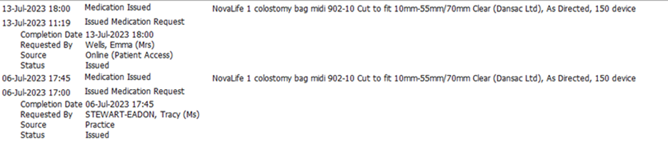

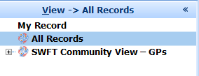
Considerations
Ordering processes – online by proxy enabled
Additional records check SWFT district nursing teams

Slide 4
Considerations
Repeat Drug | Dosage | Quantity
Alendronic acid 70mg tablets | One To Be Taken on The Same Day Each Week first thing in morning with large glass of water and remain upright (sit/stand) for at least 30minutes. Do not eat/drink or take any other medications for 30 minutes after dose | 4 tablet
Apixaban 5mg tablets | One To Be Taken Twice A Day (until reviewed in haematology clinic) | 56 tablet
Atorvastatin 20mg tablets | One To Be Taken Each Day | 28 tablet
Beclometasone 100micrograms/dose / Formoterol 6micrograms/dose inhaler CFC free | Two Puffs To Be Inhaled Twice A Day | 1 x 120 dose
Calcichew D3 Forte chewable tablets (Forum Health Products Ltd) | one twice daily- chew these | 60 tablet
Carbimazole 10mg tablets | One To Be Taken Each Day | 28 tablet
Macrogol compound oral powder sachets NPF sugar free | Dissolve the contents of One sachet in Half a glass (125ml) of water and Take Twice a day | 60 sachets
Memantine 20mg tablets | One To Be Taken Each Day | 28 tablet
Metformin 500mg tablets | Two To Be Taken Twice A Day | 112 tablet
Paracetamol 500mg tablets | Two To Be Taken Three Times A Day | 168 tablet
Propranolol 10mg tablets | Two To Be Taken Twice A Day | 112 tablet
Senna 7.5mg tablets | One Or Two To Be Taken At Night | 60 tablet
Sertraline 100mg tablets | One To Be Taken Each Day | 28
Variable use repeat drug | Directions | Quantity
Dansac Easispray adhesive remover 083-01 | Use As Directed | 250ml
Hydroxocobalamin 1mg/1ml solution for injection ampoules | One every three months | 1 ampoule
Novalife 1 Colostomy bag midi 902-10 cut to fit 10mm-55mm/70mm clear | As directed | 150 device
Nutilis Clear powder (Nutricia Ltd) | Level as advised by SALT. Make up as manufacturer's instructions. | 350 gram
Salts Aloe ring SAR25 25mm (Salts Healthcare | as needed | 30 device
Staff reporting frequent change of stoma bag required, up to 7 times daily
Limited capacity
Large volume of products in stock at the home
Two laxatives prescribed
Last TSH/T4 Sept 2022
Clinical Pharmacist discussion

Slide 5
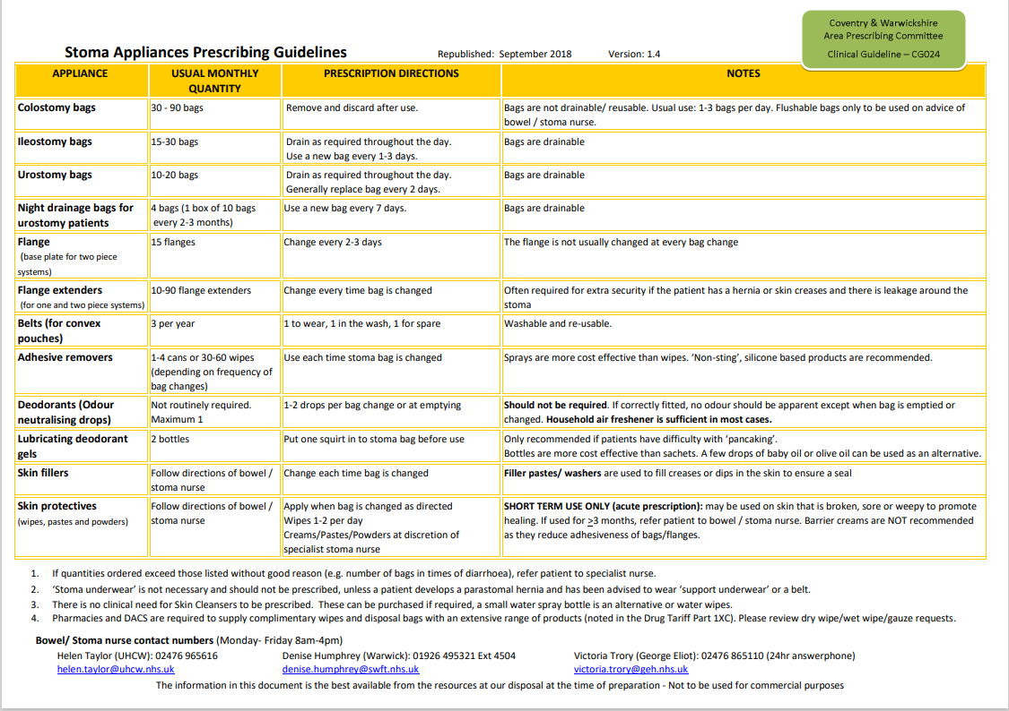
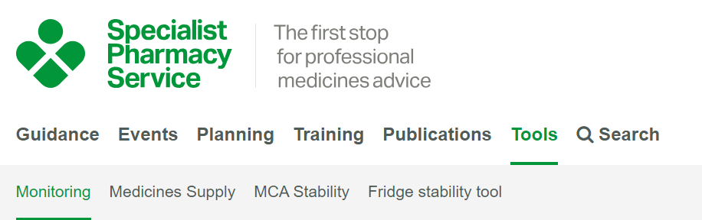

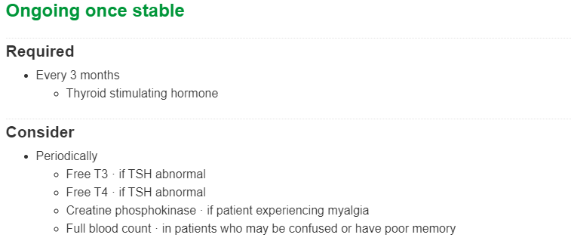
Resources
https://www.sps.nhs.uk/home/tools/drug-monitoring
https://www.covwarkformulary.nhs.uk/

Slide 6
Outcomes
Repeat Drug | Dosage | Quantity
Alendronic acid 70mg tablets | One To Be Taken on The Same Day Each Week first thing in morning with large glass of water and remain upright (sit/stand) for at least 30minutes. Do not eat/drink or take any other medications for 30 minutes after dose | 4 tablet
Apixaban 5mg tablets | One To Be Taken Twice A Day (until reviewed in haematology clinic) | 56 tablet
Atorvastatin 20mg tablets | One To Be Taken Each Day | 28 tablet
Beclometasone 100micrograms/dose / Formoterol 6micrograms/dose inhaler CFC free | Two Puffs To Be Inhaled Twice A Day | 1 x 120 dose
Calcichew D3 Forte chewable tablets (Forum Health Products Ltd) | one twice daily- chew these | 56 tablet
Carbimazole 10mg tablets | One To Be Taken Each Day | 28 tablet
Memantine 20mg tablets | One To Be Taken Each Day | 28 tablet
Metformin 500mg tablets | Two To Be Taken Twice A Day | 112 tablet
Paracetamol 500mg tablets | Two To Be Taken Three Times A Day | 168 tablet
Propranolol 10mg tablets | Two To Be Taken Twice A Day | 112 tablet
Senna 7.5mg tablets | One Or Two To Be Taken At Night | 56 tablet
Sertraline 100mg tablets | One To Be Taken Each Day | 28
Variable use repeat drug | Directions | Quantity
CliniPeel No Sting medical adhesive remover aerosol 4501 (CliniMed Ltd) | As directed | 150 ml
Hydroxocobalamin 1mg/1ml solution for injection ampoules | One every three months | 1 ampoule
Nutilis Clear powder (Nutricia Ltd) | Level as advised by SALT. Make up as manufacturer's instructions. | 350 gram
Salts Aloe ring SAR25 25mm (Salts Healthcare | as needed | 30 device
Welland Aura Plus soft convex colostomy bag with filter, maxi 1C1N336213 Cut to fit 13mm-35mm Clear (Welland Medical Ltd) | As directed | 90 device
GP Tasked with findings
Macrogol sachets stopped
Bloods requested for TSH/T4
Further discussion on ward round
Referral to Stoma Team
Carer stoma training provided
Change to colostomy bags
Change to DAC
Discussion with new DAC - ordering
Care Home manager feedback
‘Hi Donna,
Thank you very much for your help. The new suppliers
are great and the new products are really good!’

