Slide 1



Medicines Optimisation:
Arden & GEM Commissioning Support Unit (CSU)
Natasha Jacques: Lead Pharmacist – Primary Care

Slide 2

Contents
Functions and roles of the MO team
Secondary Care support
Strategic work
Reactive advice
Prescribing Incentive Scheme
QIPP
Questions

Slide 3
Introducing the Arden & GEM MO Team
Jo Loague - Head of Service: Medicines Optimisation & IFR
Natasha Jacques & Michelle Haddock- Primary care lead pharmacists
Jas Sagoo- Secondary care lead pharmacist
Team of pharmacists and technicians supporting Warwickshire
Contact us via email on agcsu.medicines@nhs.net

Slide 4
Roles & Functions of the MO team
Strategic and operational Medicines Management service
Prescribing and MO services across:
Primary care,
Secondary care,
Local authorities,
Specialised services,
NHS England regions
Local decision-making through:
Individual funding requests (IFR),
Area Prescribing Committee (APC)
ICB policy development

Slide 5
Secondary Care
Joint working with Acute Trusts within Coventry & Warwickshire
Ensuring Secondary Care colleagues aware of relevant Primary Care Incentive Schemes
Assurance – national & local guidance
Drafting local policies for ICB:
Sativex position statement
Commissioning in Medicines Management
Discussions around shared care

Slide 6

Primary care functions include:
Interface liaison with secondary care
APC attendance and input in local formulary
Prescribing data analysis – ePACT2, PrescQIPP®
Practice support – SOPs, audits, medicines safety
Monitoring interventions – MHRA alerts, high risk drugs e.g. DOACs
QIPP, Prescribing Incentive Scheme, financial planning
Proactive Advice: Newsletters, ScriptSwitch®
Reactive Advice: Queries including Medicines Information (MI) provision
PrescQIPP® link
Education and training sessions for PCNs, practices e.g. WN nurse forum

Slide 7
Strategic Medicines Support:
Horizon scanning
Budget setting (ICB and practice level)
Interpretation of national policy, guidance e.g. NICE
Medicines related policy development
Recent development of:
Quality audit schemes- currently working on dual antiplatelets audit in WN
Prescribing Incentive Scheme
Prescribing efficiency programme
Non-Medical prescribing dashboard

Slide 8
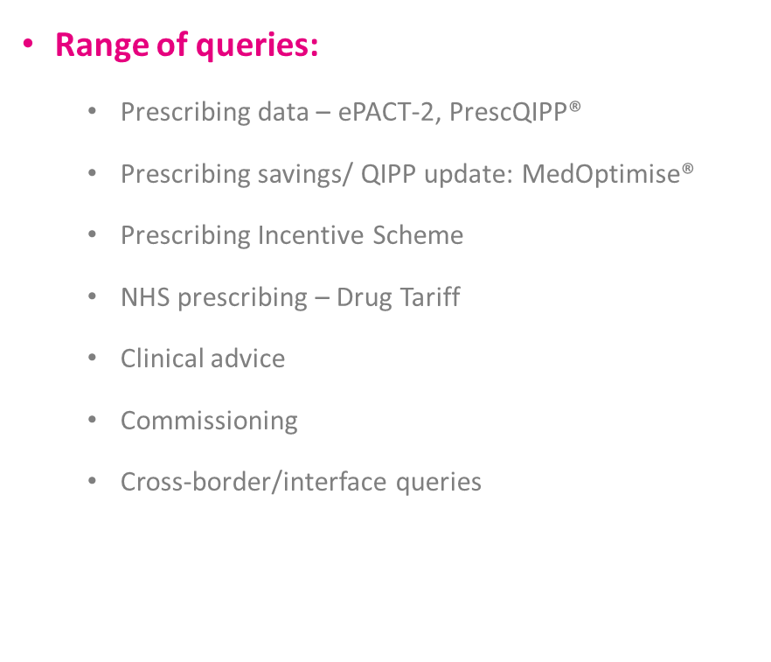
MI Queries (Reactive Advice)
A member of the MO Team will respond within 3 working days
Range of queries:
Prescribing data – ePACT-2, PrescQIPP®
Prescribing savings/ QIPP update: MedOptimise®
Prescribing Incentive Scheme
NHS prescribing – Drug Tariff
Clinical advice
Commissioning
Cross-border/interface queries
Examples of clinical queries:
Local formulary status e.g. shared care, specialist advised
Local guidelines
Evidence for use of a drug in a certain indication
Side effects
Interactions
Swallowing difficulties / suitability of medicines for enteral tubes
Pregnancy/breastfeeding
Seeking advice of Regional MI Centre

Slide 9
Prescribing Incentive Scheme
Started 1st June 2022 and will finish on 31st May 2022
102 practices have signed up to the scheme across the ICB
50% of payment awarded if practice stays within indicative allocated prescribing budget
Budget set on fair share basis taking into account a number of factors such as list size, care home residents, disease registers e.g. diabetes, respiratory patients
50% of payment awarded if practices deliver 2 out of the 4 quality schemes
Diabetes- review of DPP4i, needles, blood glucose testing strips
Respiratory- audit of patients on high dose inhaled corticosteroids, reduction of ICS spend
Opioids- review of patients on opioids and reduction of opioid spend
Self-Care- to run 3 campaigns over the 12 months and show reduction in self-care spend

Slide 10
MedOptimise
MedOptimise access (free of charge) will be required for practices
Enable practices to see their progress for;
prescribing budget
spend and target reductions for the quality schemes
Practices that have signed up to the self care will need to upload evidence of their campaigns
Respiratory audits will need to be completed on MedOptimise
Access to MedOptimise can be requested via
Agcsu.medicines@nhs.net for Warwickshire based practices
Prescribing support team for Coventry practices

Slide 11
Prescribing efficiencies/QIPP support in Warwickshire
Offer to all practices that CSU team will work with practice to deliver a suite of QIPP line savings
Initial offer- Savings relate to switching drugs within respiratory, opioids, gastroenterology and mental health
CSU team will identify potential patients, review records to ensure switch is appropriate and once patient list agreed with practice will contact patient via agreed method e.g. letter, phone call
Savings generated will support practices with incentive scheme and generate wider NHS savings

Slide 12
GP-Community Pharmacy Consultation Service (GP-CPCS)
Providing training for GP practices and operational implementation of CPCS
initially focussed on Rugby practices and work underway with Warwickshire North
Practice training pack has been developed
Training for GP reception staff
Drop- in sessions (virtual) to support implementation
Close working with LPC to help overcome barriers
Developed a monthly ICB dashboard of GP-CPCS referrals
Single point of contact for GP-CPCS queries

Slide 13




Thank you
The Medicines Optimisation (MO) Team: Role and Support
Natasha Jacques: Lead Pharmacist – Primary Care
agcsu.medicines@nhs.net
www.ardengemcsu.nhs.uk
@ardengem
www.linkedin.com/company/arden-&-gem-csu

