Slide 1
BECOMING A SKILLED WORKER VISA SPONSOR
A GUIDE FOR GP PRACTICES
July 2021

Slide 2
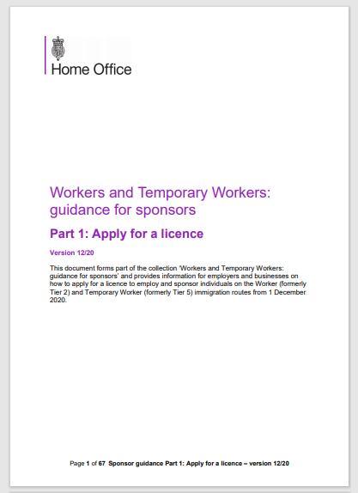
Introduction to becoming a sponsor
If you want to recruit a GP from outside the UK and they are not a 'settled worker’ or if you want to recruit a UK medical graduate switching from a Tier 4 visa, they are likely to need a Skilled Worker visa and you will need to sponsor them. (The Skilled Worker visa replaced the Tier 2 (General) visa from 1 December 2020.)
This ensures:
The Home Office knows they have secured a job in the UK; and
That an employer is able to take responsibility for them while they are here.
To do this, GP practices will need a sponsorship licence. This process is not complex but the guidance around it is quite long. This is because the official Home Office guidance needs to cover every sector in the economy, along with every possible scenario.
This guide is a simplified version that should help you:
Complete the online registration process; and
Identify the right documents you’ll need to send to the Home Office as part of your registration.
Please note, we have only provided guidance on the questions which we think will be the most difficult to answer, not the entire application form. We have indicated which part of the process is being described on each slide.
This guidance does not replace official Home Office sponsor guidance (specifically refer to “Part 1” and “Appendix A”), but this guidance should help you get through the registration process with ease.
Let’s get started…
To note: You do not need to sponsor EU, EEA or Swiss citizens with status under the EU Settlement Scheme; Irish citizens; people with 'indefinite leave to remain' in the UK, or people who have another type of immigration permission to work. For full guidance on who needs to be sponsored, see Section S1 of Part 2: Sponsor a worker

Slide 3

What you need before you start
DOCUMENTS
You will need to send the Home Office a minimum of 4 supporting documents to prove you are a legitimate employer within 5 working days of submitting your application. These are set out in full in the sponsor guidance appendix a. You can send these electronically. A simplified list of example documents which may be most relevant for a GP Practice is below.
Recommended documents
Corporate/Business Bank Statement (mandatory for start-ups operating for less then 18 months) or supporting letter from your bank manager
Employers Liability Insurance Certificate; and
CQC registration document.
HMRC Registration – PAYE Reference Number/Account Office Reference Number
Proof of ownership or lease of your business premises. If you send a copy of your lease agreement, it must be signed by all parties concerned.
HMRC VAT registration certificate
Latest acknowledgement of a Company Tax Return CT620, or the completed CT600 tax return and the CT603 notice.
You will also need the GMC registration details of the senior partner of the GP practice (mandatory).
KEY PEOPLE
In order to complete an application, you will need to assign three key personnel to manage your sponsorship process. These roles can all be filled by the same person . These roles are:
Authorising officer (AO) – this will be your most senior person responsible for the recruitment of all migrant workers and ensuring that all of your sponsor duties are met.
Key contact – this person will act as the main contact between the Home Office and the practice.
Level 1 user – this person will carry out your day-today sponsorship activities.
Level 2 user – this is an optional role and you do not need to initially assign it (typically used by very large employers).
For a full description of each role, please see Section L4 in Part 1 of the Sponsor Guidance
COST
The cost depends on the size of your practice. For small or charitable sponsors the fee is £536. For a medium or large sponsor the fee is £1,476. You’re usually considered a small business if you meet two of the following conditions: annual turnover is £10.2 million or less, balance sheet is £5.1 million or less or you have 50 employees or fewer.
The fee is non-refundable if your application is refused (i.e. doesn’t meet the requirements). If your application is rejected because it is invalid (i.e. full fee not paid or mandatory documents not submitted) the fee is refundable.

Slide 4

The registration process and setting up
your online account
Setting up an online account (2 minutes)
Completing the online form (20 minutes)
Finding the relevant documents (10 minutes, depending on how good your filing is!)
Setting up an online account
To set up an account, click here*; then:
Enter your name and your email address.
The next page will give you a short UserID. Keep this safe, you’ll need it each time you log in.
You will be emailed a temporary password – click the link in the email to reset your password to something memorable and secure. Keep this safe and log into the system.
*https://www.points.homeoffice.gov.uk/gui-sponsor-jsf/Register/SponsorRegister.faces

Slide 5


The Online Application
Visa Route: Step 1 of 1
Having logged onto the application system, click ‘Apply for a sponsor licence’.
This will take you to your first questions, about the kind of licence you require. Choose Skilled Worker
Where it asks if you are already on the register of sponsors, select: No

Slide 6

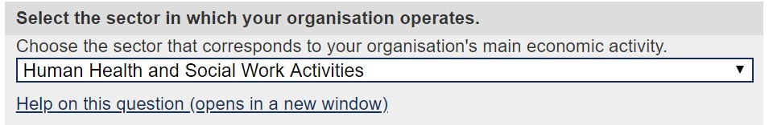
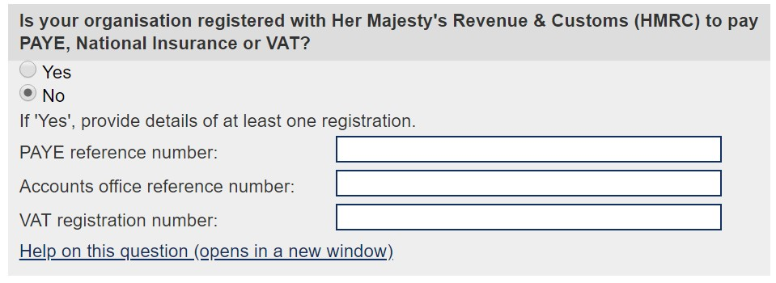
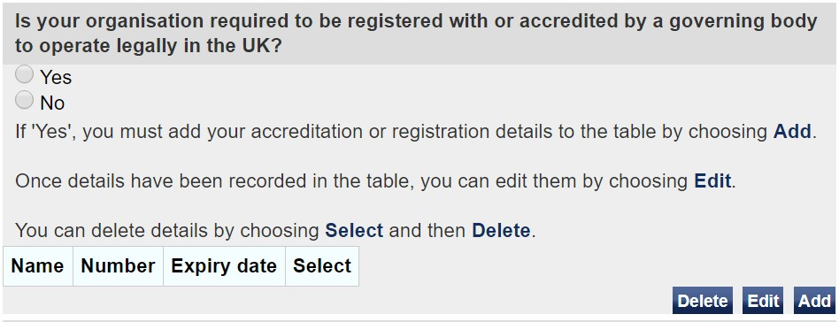


The Online Application – Organisation
Organisation: Step 3 of 4
What type of organisation is the practice. It is likely that the practice will be a Partnership, Limited Liability Partnership (LLP) or a limited company. If you are unsure, check the practice’s incorporation documents.
When asked what sector your organisation operates in, you should select ‘Human Health and Social Work Activities’.
The practice will likely pay both PAYE tax and National Insurance, because the practice has employees. The practice may also have a VAT registration number.
It is important to provide this information because your HMRC registration will help the Home Office to confirm the authenticity of the practice and who the people working at the practice are, and that you are paying the worker in line with the Immigration Rules and sponsor guidance.
Next you will need to provide details of any memberships or accreditations that the practice is legally required to have with a governing body. We recommend that you use your CQC registration documents. Your CQC registration is legally required and so this satisfies the Home Office criteria for this option. These details will include the governing bodies name, your registration number and when your membership expires.
You will also need to provide details of any non-legally required memberships or accreditation. Specifically, this the GMC membership details of the senior partner at the GP practice.

Slide 7

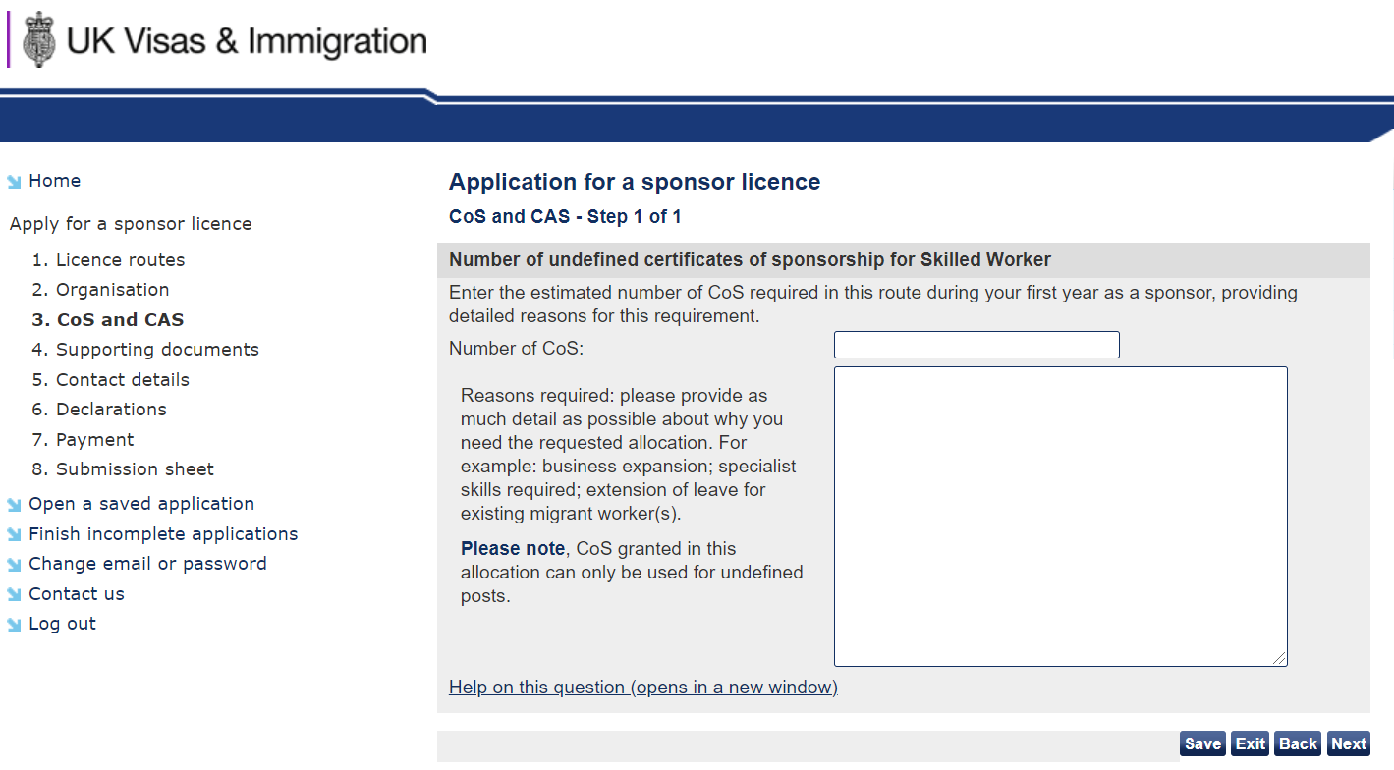
The Online Application – CoS
CoS and CAS: Step 1 of 1
You’ll now need to enter how many Certificates of Sponsorship (CoS) you need and explain why. There is no restriction on the number of CoS that can be granted (however it should be proportionate to the size of your organisation).
Undefined (previously unrestricted) CoS are for individuals already in the UK.
Defined (previously restricted) CoS are for individuals applying from overseas.
The allocation of undefined CoS is valid for a 12 month period.
We have provided the below example text to use when explaining why you need your CoS. This can be tailored to reflect your individual practice circumstances (limited to 2000 characters):
The UK has a national shortage of qualified General Practitioners to meet the growing demands of the population. Typical recruitment efforts have not provided us with the suitable candidates required to fulfill General Practitioner roles within our practice. The impact of this is extended waiting times for patients and greater pressure on our current workforce to meet the needs of our patients.
The role of a General Practitioner is one that requires many years of specialist training including: a full medical degree, two years of foundation medical training and at least three years of specialist GP training. While there are concerted national efforts to increase the numbers of available GPs in the UK, this does not address the immediate pressure in our service and, for this reason, we anticipate needing to recruit from overseas.
The role of a General Practitioner has been included on the UK Shortage Occupation list as of 6 October 2019.

Slide 8

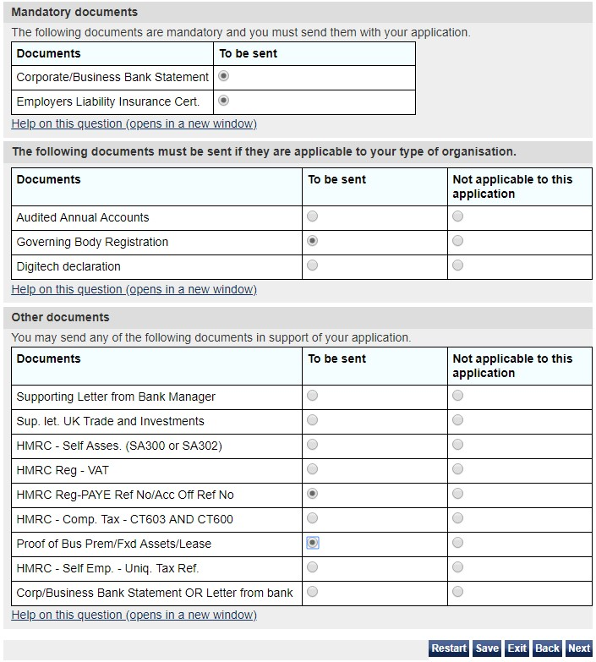

The Online Application – Documents
Supporting Documents : Step 1 of 1
Remember the documents you pulled together from the lists on slide 3? This next page asks you to tick-off the ones you have to support your application.
For the full Home Office guidance on supporting documents please click here and also see Section L7 Part 1 of the sponsor guidance.
We recommend that, in providing ‘Governing Body Registration’ documents, you use your CQC registration documents.. Your CQC registration is legally required and so this satisfies the Home Office criteria for this option. The guidance states that you do not need to provide your registration documents because the Home Office can conduct its own checks. We recommend that you provide the registration documents with your application in order to avoid unnecessary delay.
You must choose 2 documents from the list in the section entitled ‘Other documents’. If you fail to provide at least two further documents, your application may be refused by the Home Office.
You should scan or take pictures of your supporting documents and send them to the email address given on the sponsor submission sheet.
If you are unable to provide the submission sheet and supporting evidence digitally, you can contact the Home Office using the contact details given on the submission sheet

Slide 9

Final steps and useful contacts
Your application is not complete until you have paid and sent the Home Office your submission sheet and supporting documents.
Information on where to send your submission sheet and supporting documents are provided at the end of the application process, once your payment has been made.
How long it takes to get a decision
Most applications (8 out of 10) are dealt with in less than 8 weeks.
You may be able to pay £500 to get a decision within 10 working days. You’ll be told if you can after you apply.
Help and advice
If you do have any difficulty with the application, further advice can be obtained from the sponsorship, employer and education helpline:
Telephone:
0300 123 4699
Monday to Thursday, 9am to 5pm
Friday, 9am to 4:30pm
Or email
businesshelpdesk@homeoffice.gov.uk

Slide 10
Useful Tips!
On starting the application make sure you copy your User ID as you will only receive this once
Step 3 of 4 - Human Health & Social Work Activities
- Single body
Partnership or Private Limited Company
Governing body – Care Quality Commission (CQC)
COS –remember to always have allocation on your licence. The Home Office will write you to update annually ( be realistic)
Copy and paste the paragraphs in italics to the application for reasons required
Remember you need to submit Senior Partners details including DOB as submitted to the GMC

Slide 11
Useful Tips!
When submitting documents – those highlighted in red seem to be easiest to find for practices, you will need 4 of these documents
Corporate/Business Bank Statement (mandatory for start-ups operating for less then 18 months) or supporting letter from your bank manager
Employers Liability Insurance Certificate; and
CQC registration document.
HMRC Registration – PAYE Reference Number/Account Office Reference Number
Proof of ownership or lease of your business premises. If you send a copy of your lease agreement, it must be signed by all parties concerned.
HMRC VAT registration certificate
Latest acknowledgement of a Company Tax Return CT620, or the completed CT600 tax return and the CT603 notice.

