Slide 1
Matthew Bowden
Transformation Fellow
2020-21

Slide 2


Slide 3
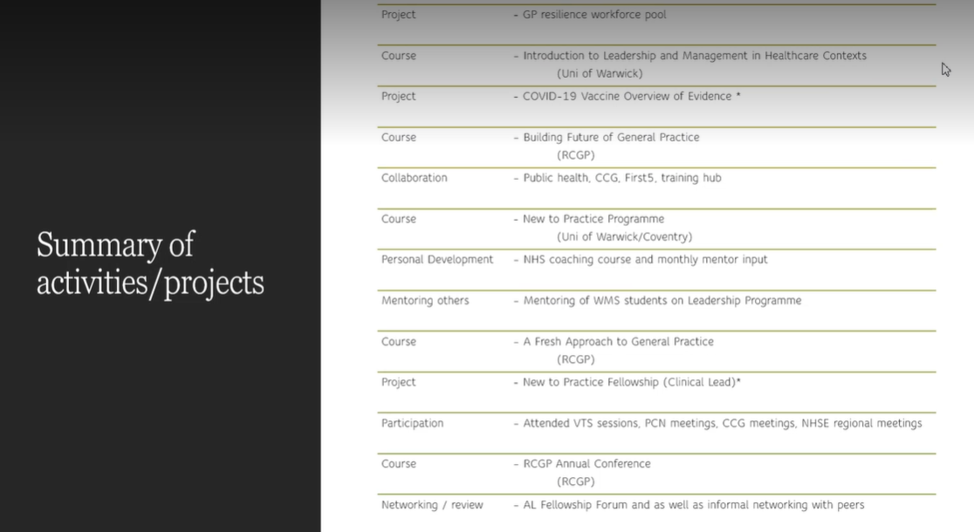

Slide 4
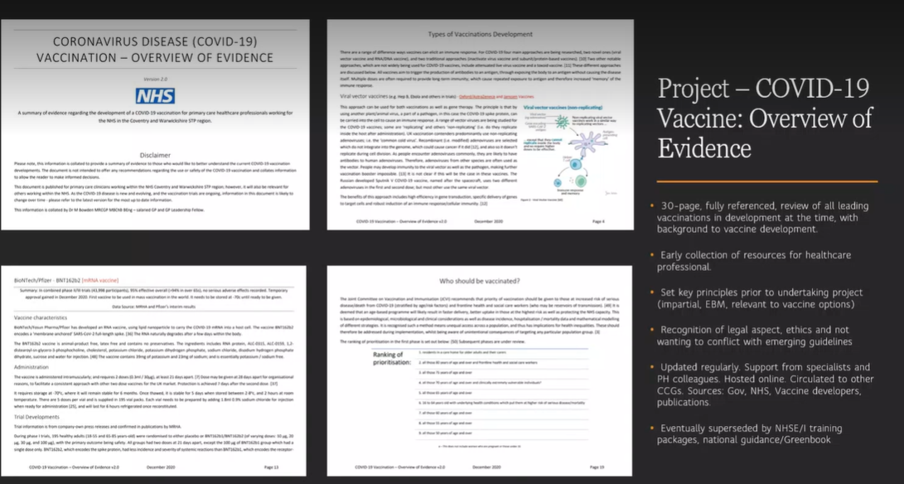

Slide 5
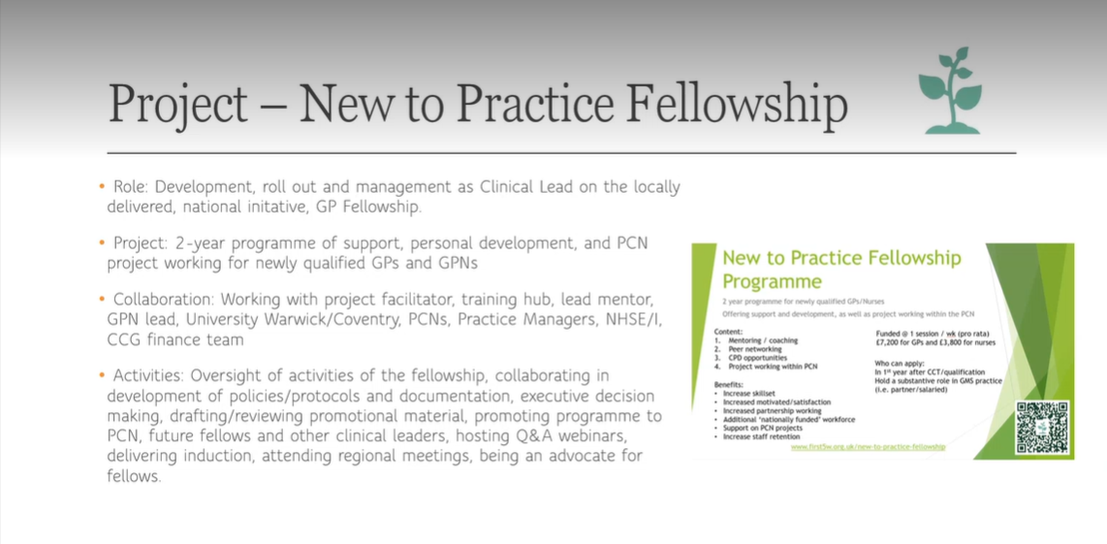

Slide 6
